Slide 1

Interactive Online Choir Lessons

Slide 2
Domine, Fili, Unigenite
Composed by Antonio Vivaldi
Lesson by Dr. J.D. Frizzell

Slide 3
Background
Lesson # 1
Includes Sections on:
The Composer
The Geographical Region
The Musical Stylistic Period
The Composition

Slide 4
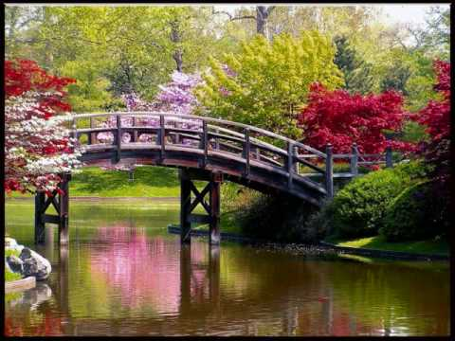
About the Composer
Antonio Vivaldi (1678-1741) was an Italian Baroque musical composer, virtuoso violinist, teacher, and Roman Catholic priest. It is important to note that at the time, Italy was not a country yet, so technically Vivaldi was from Venice, the capital of the Venetian Republic (Repubblica di Venezia).
One of the most famous and prolific Baroque composers, Vivaldi wrote 500 concertos, 46 operas, and dozens of sacred choral works. His most famous concerto is called The Four Seasons. You may recognize the Spring movement:

Slide 5
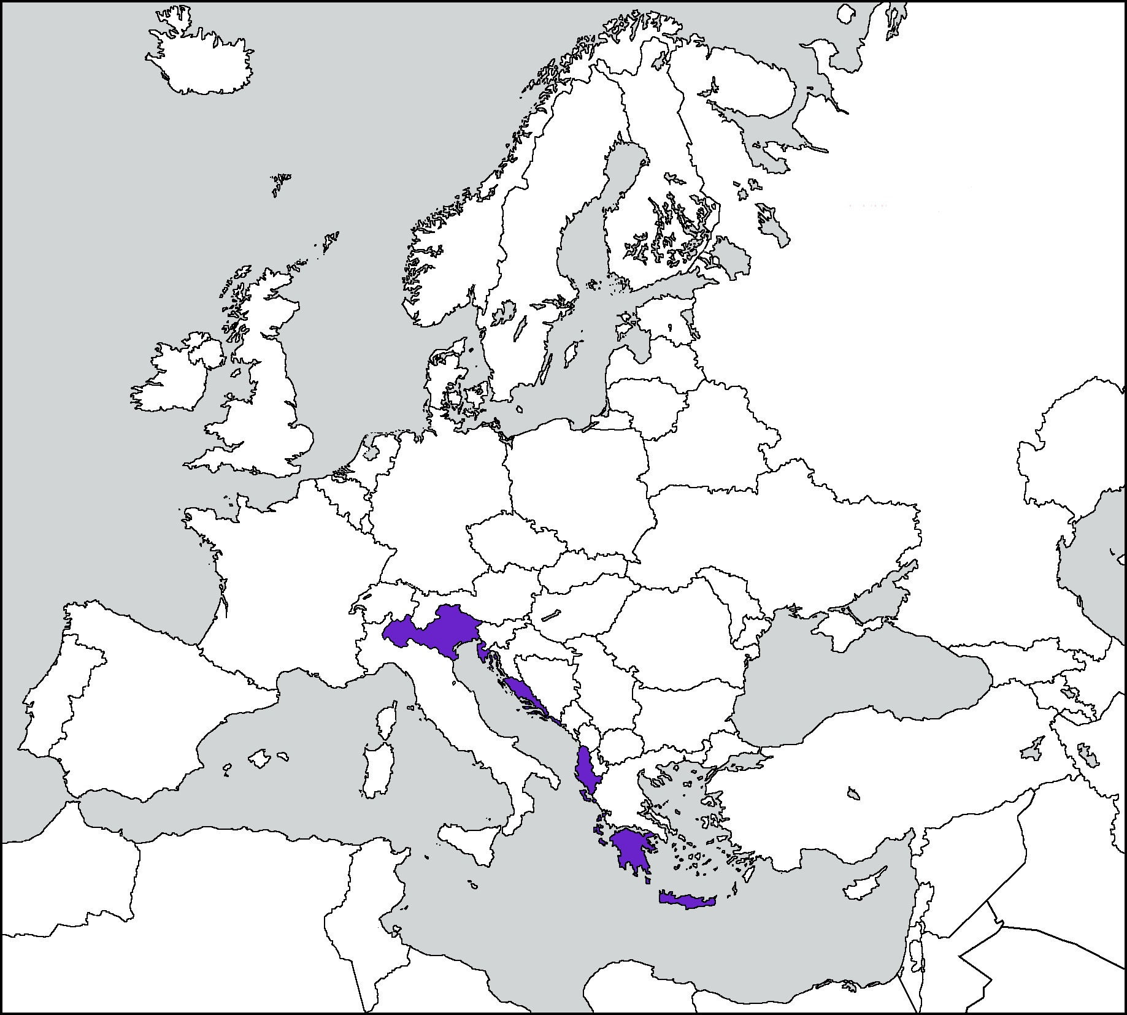
The Venetian Republic
The Venetian Republic lasted from 697-1797. Located in what is now northeastern Italy, it extended through modern day Greece and Cyprus. A trading power, the Venetian Republic was ruled by a doge (dōj) along with a powerful group of nobles, aristocrats and merchants called the Great Council of Venice.
By Reincanarietheorie - Own work, CC BY-SA 4.0, https://commons.wikimedia.org/w/index.php?curid=71706621

Slide 6
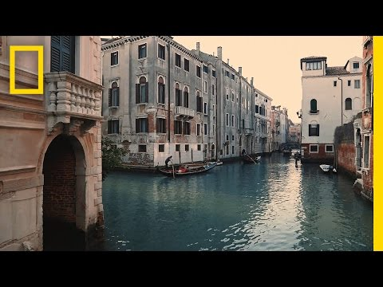
Venice Today

Slide 7
The Baroque Period
1600-1750
Medieval Period (800-1400)
Renaissance Period (1400-1600)
Baroque Period (1600-1750)
Classical Period (1750-1820)
Romantic Period (1820-1910)
Modern Period (1910-present)

Slide 8
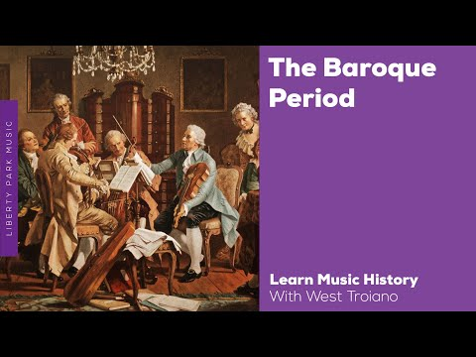
The Baroque Period

Slide 9
The Baroque Period Musical Characteristics
Development of key signatures
Key signatures define a clear tonal center to a piece or section
Use of figured bass
Employs an accompanimental instrument like harpsichord or organ to
realize a bass line with “figures” to create the full harmony
Development of the orchestra
Many instruments playing together, at this time usually strings plus wind
and/or brass instruments
Use of counterpoint
Two or more melodic lines combined
Use of terraced dynamics
Sudden shifts from soft to loud or vice versa. Think of terraces like levels--
instead of gradual crescendos and decrescendos, there are abrupt
changes like steps.

Slide 10

The Composition
Gloria (Chorus)
Et in terra pax (Chorus)
Laudamus te (Sopranos I and II)
Gratias agimus tibi (Chorus)
Propter magnam gloriam (Chorus)
Domine Deus (Soprano)
Domine, Fili unigenite (Chorus)
Domine Deus, Agnus Dei (Contralto and Chorus)
Qui tollis peccata mundi (Chorus)
Qui sedes ad dexteram Patris (Contralto)
Quoniam tu solus sanctus (Chorus)
Cum Sancto Spiritu (Chorus)
Gloria was written while Vivaldi was working at the Ospedale della Pietà, an orphanage for girls. It has twelve movements and was most likely originally sung by all women. The movements are based on the Gloria from the Ordinary of the Roman Catholic Mass and they alternate between soloists and choir.

Slide 11
Music Theory
Lesson # 2 and Lesson #3
Includes These Topics:
Score Organization
Tonal Centers/Key Signatures
Melody and Countermelody
Melodic Fragmentation
Sequences

Slide 12
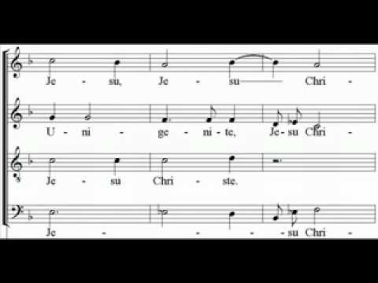
Music Theory
Listen to a performance of Domine, Fili, Unigenite as performed by The Chamber Orchestra of Lausanne, conducted by Michael Carboz. Follow along with the score.

Slide 13
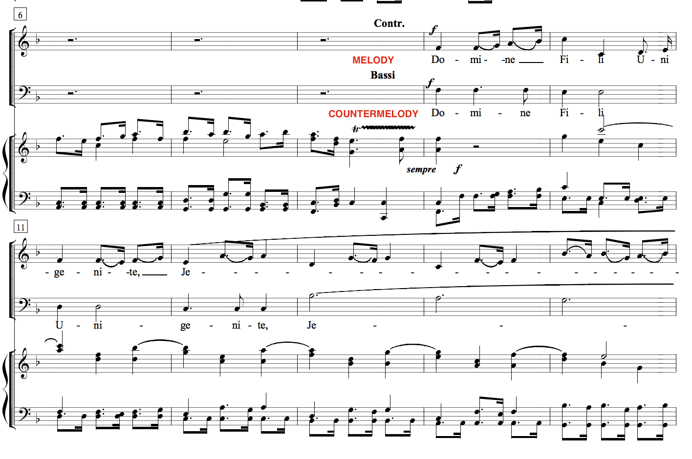

Music Theory
The piece begins with an orchestral introduction followed by the altos singing the melody. They are joined by the basses singing the countermelody. Both melodies start on the pitch F, which is the tonal center of the key signature for this movement.
Singers either call the tonal center of a piece scale degree 1 or “do”.
Later in this lesson, when you are asked to find the tonal center of a section, find the first note of the melody-- it is the key!

Slide 14
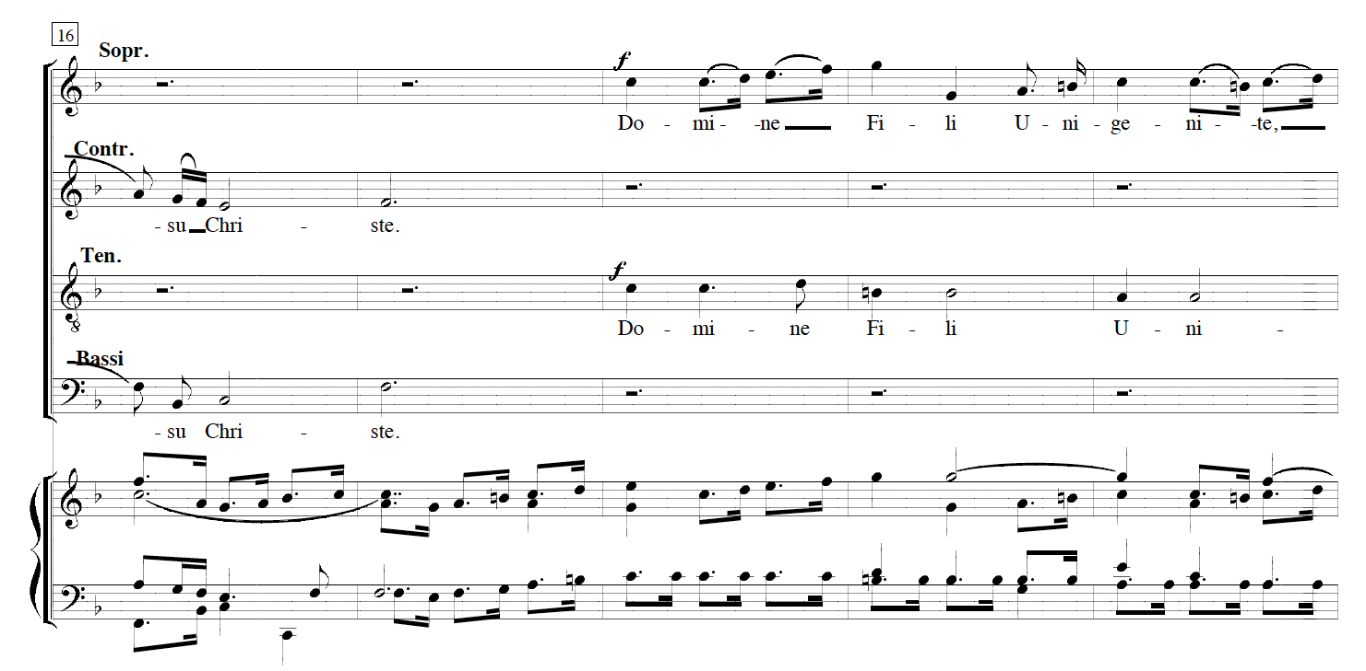
Music Theory
Look at the next phrase starting at measure 18.
Which voice part sings the melody?
Which voice part sings the countermelody?
What is the starting pitch of both the melody and the countermelody here?

Slide 15
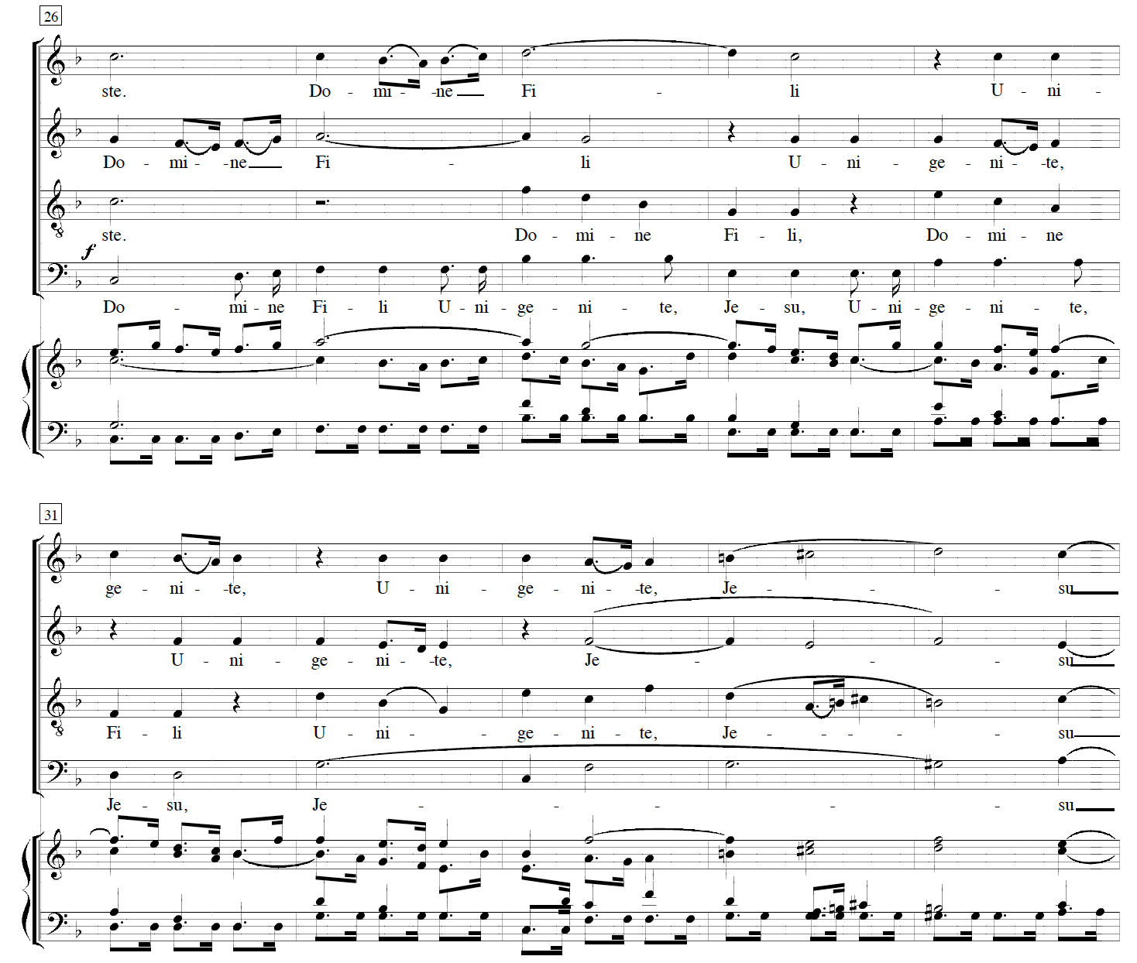
Music Theory
The fourth phrase finally sees the entrance of all four voices parts at once.
Instead of a melody and countermelody, the voice parts use melodic fragmentation. Melodic fragmentation is when a small part of the melody is used and developed.
The first fragment occurs in the alto part in measure 26. This fragment is repeated with variation in the next measure in what voice part?

Slide 16
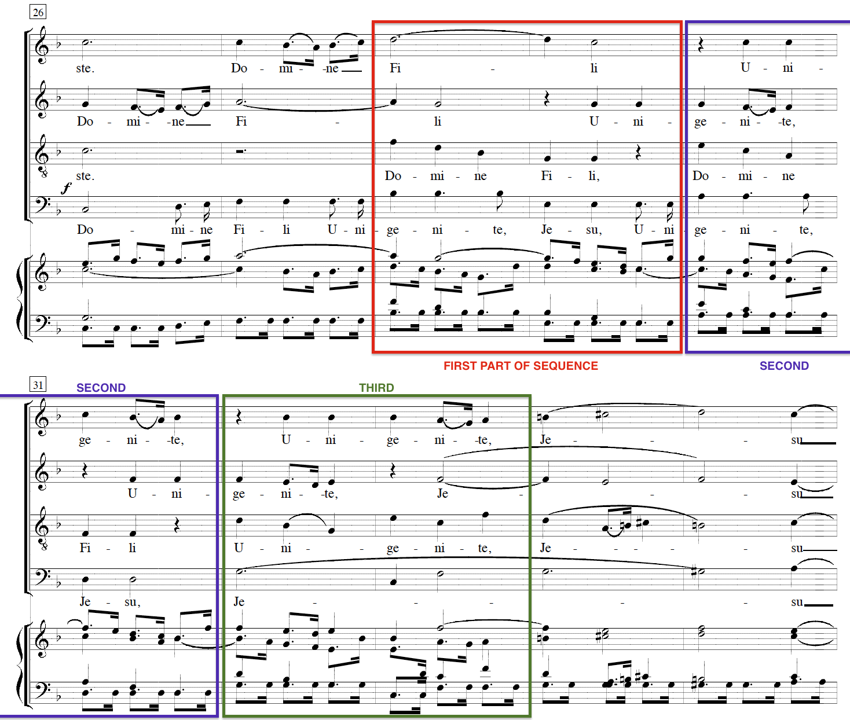
Music Theory
Harmonically, this section uses what is called a sequence. A sequence is a series of pitches and rhythms repeated at different pitch levels.
Look at the tenor part as an example of this. What pitch does the tenor start on in the first part of the sequence? What pitch does it start on in the second? The third?
Can you identify the pattern?

Slide 17
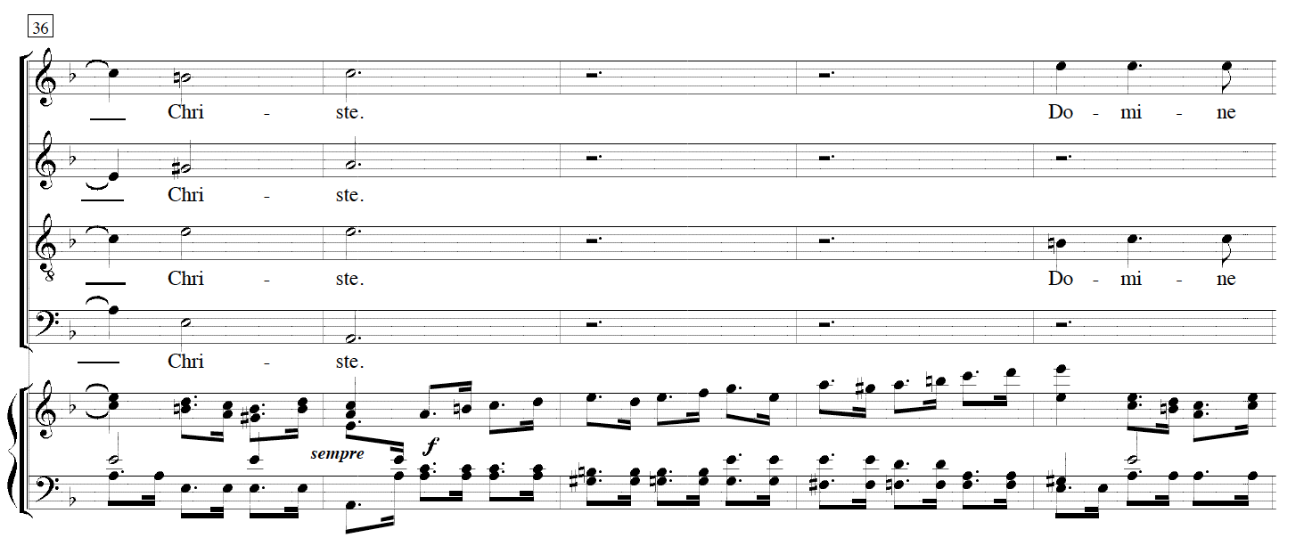
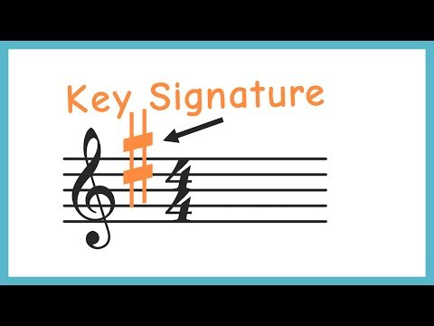
Music Theory
The fourth phrase ends at measure 37 with a cadence in the key of a minor. A cadence is a melodic or harmonic configuration that creates a resolution, usually at the end of a phrase.
Even though the tonal center has shifted to a minor, the key signature in the music has not changed. Rather, the composer uses accidentals to create the new key. This is quite common in the Baroque period.
Need a review on key
signatures? Watch this!

Slide 18
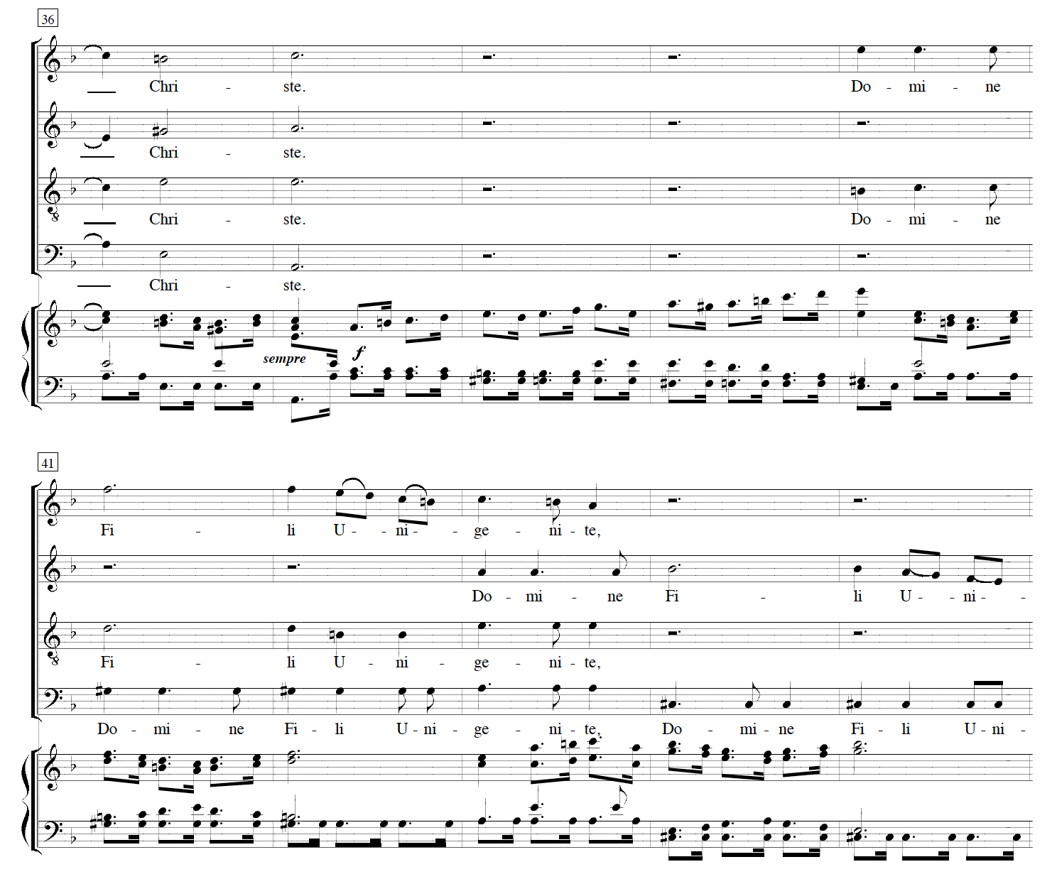
Music Theory
What compositional tool does Vivaldi again use here in the fifth phrase? (hint: small repeated sections)

Slide 19
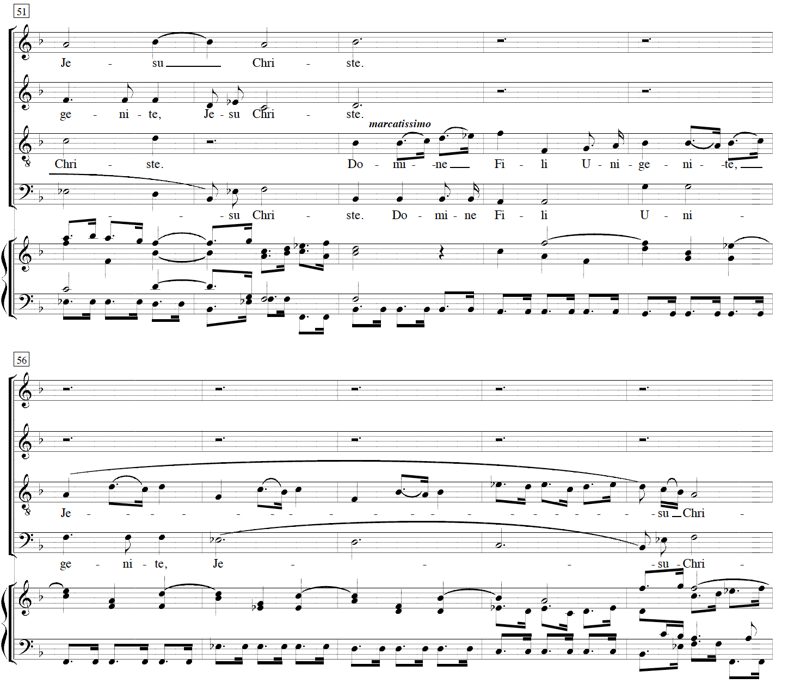
Music Theory
The sixth phrase begins in what tonal center (key) at measure 53?
Which voice part has the melody?
Which voice part has the countermelody?

Slide 20
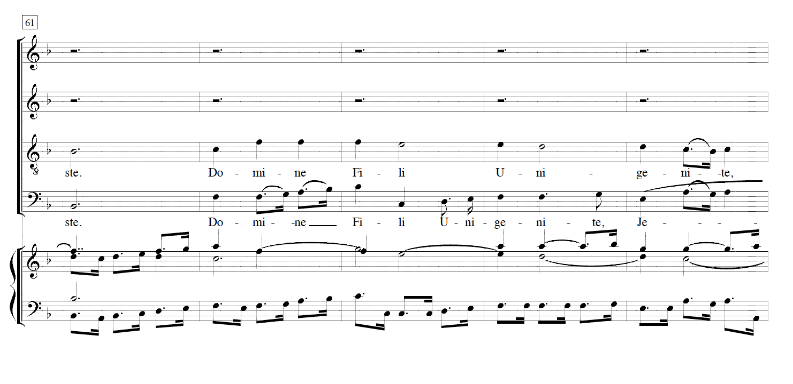
Music Theory
The seventh phrase is centered around what key?
Which voice part has the melody?
Which voice part has the countermelody?
What is different about this phrase compared to the previous phrases with melody and countermelody?

Slide 21
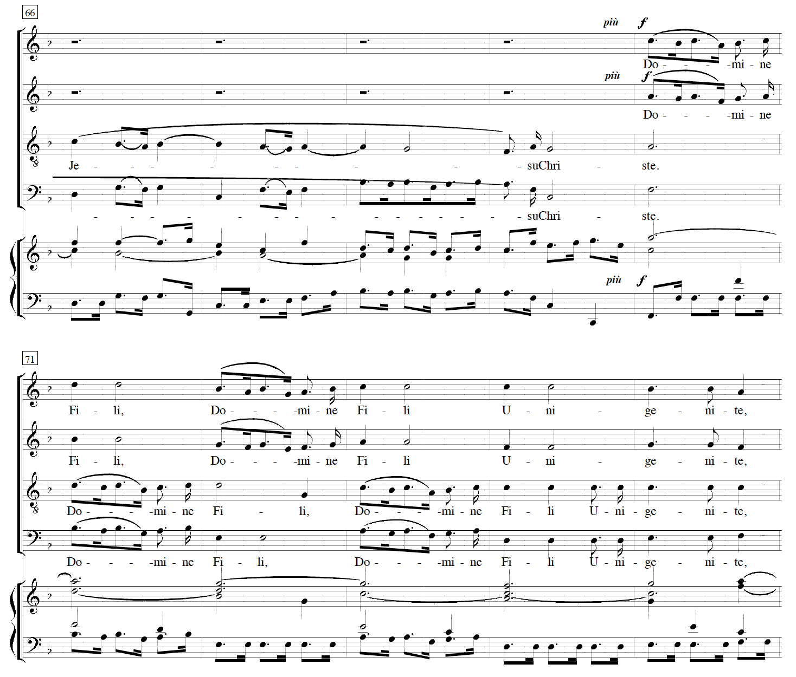
Music Theory
The eighth phrase, starting at measure 70, contains paired voices in what is called duetting.
What are the two paired groups of voices?
What compositional device does Vivaldi employ once again in this phrase? (hint: think patterns)

Slide 22
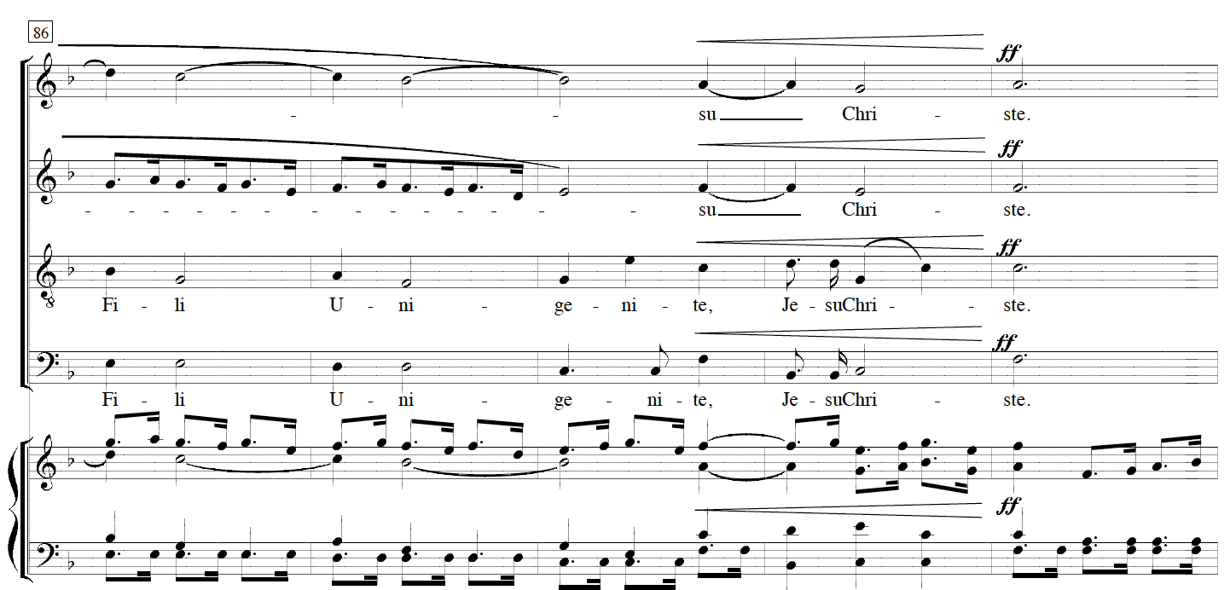
Music Theory
Look at the final cadence of the voice parts in measures 88-90.
Notice how the soprano and alto parts reinforce a rhythm of half notes starting at measure 88, thereby creating a momentary feeling of being in a time signature of 2/4 instead of 3/4.
This overlapping of one time signature onto another is called hemiola, and it became quite common in Baroque and Classical period music.

Slide 23
Vocal Technique
Lesson # 4

Slide 24
Vocal Technique
First practice speaking the opening line in Latin.
Latin was the language used by the Roman Catholic Church for their services. In fact, in many places today, Latin is still used in Roman Catholic churches.
Domine Fili Unigenite, Jesu Christe
Record yourself speaking this first line after you have practiced it a few times. Focus on making pure, open vowels.

Slide 25
Vocal Technique
Now that you have practiced the Latin, sing the opening melody along with the alto. If you would prefer, you may sing this melody an octave lower.
Notice the articulation of the singer, who is lifting after the first note of each measure. This separation between notes is called staccato.
The other notes are connected, or legato.
Once you have finished practicing, please record yourself singing this line. You may sing along with the recording if it is helpful. Be patient-- it may take up to 15 minutes or so to get it!

Slide 26
Listening and Evaluating
Lesson # 5

Slide 27
Listening and Evaluating
Listen to the following two performances of Domine, Fili, Unigenite.

Slide 28
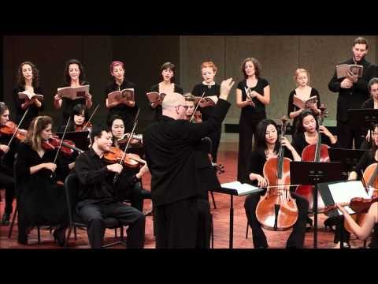
Listening and Evaluating
University of North Texas: Collegium Singers & Baroque Orchestra
Richard Sparks, conductor

Slide 29
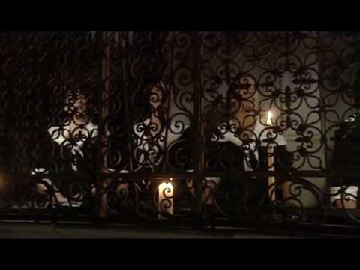
Listening and Evaluating
Vivaldi’s Women (Schola Pietatis Antonio Vivaldi)
The OAE/Jerwood Experience
Note that these performers are recreating the original performance setting, including having women sing all voice parts, singing behind barriers, and performing in a church.

Slide 30
Listening and Evaluating
Describe the similarities and differences between the two performances in
the following areas: tone, tempo, and dynamics
Which performance do you prefer? Why?

