Slide 1

Online Interactive Choir Lessons
Click on this link for the Google Slides Presentation:
https://docs.google.com/presentation/d/1uzViVrUjH3jIhegnM6tMCslEw6bYvp4vgbNfGAF8bf8/edit?usp=sharing
Click on this link for the student answer sheet:
https://docs.google.com/forms/d/1p3cuZK6LhxtplZuC0oygNfUdy-0cL7E3VIMKeGTxPOw/edit?usp=sharing
YOU WILL NEED TO MAKE A COPY OF THE STUDENT ANSWER FORM BEFORE USING IT. Do not use the form without first making a copy. After making a copy, you will be prompted to reconnect the folder for student submissions. Click “relink”.

Slide 2
Middle School Choir Primer
Introduction to score reading

Slide 3
The musical alphabet uses the letters A through G
A B C D E F G

Slide 4
The letters continue in either direction.
A B C D E F G
E F G
A B C D E F G
A B C

Slide 5
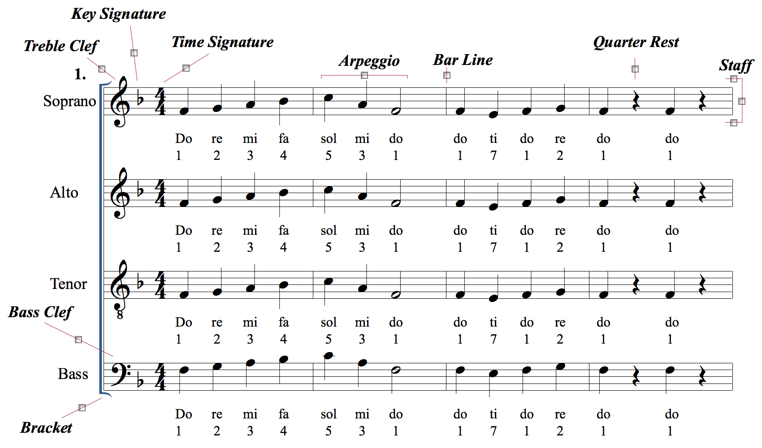
This is what the beginning of most of your music will look like.

Slide 6
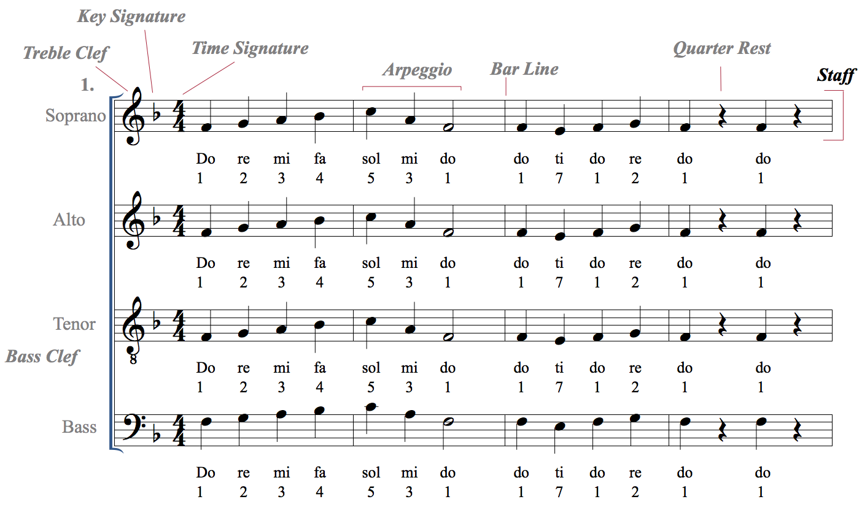
The staff is a set of five horizontal lines and four spaces. Each line or space holds a different note, or pitch.
Multiple staffs are called
staves

Slide 7
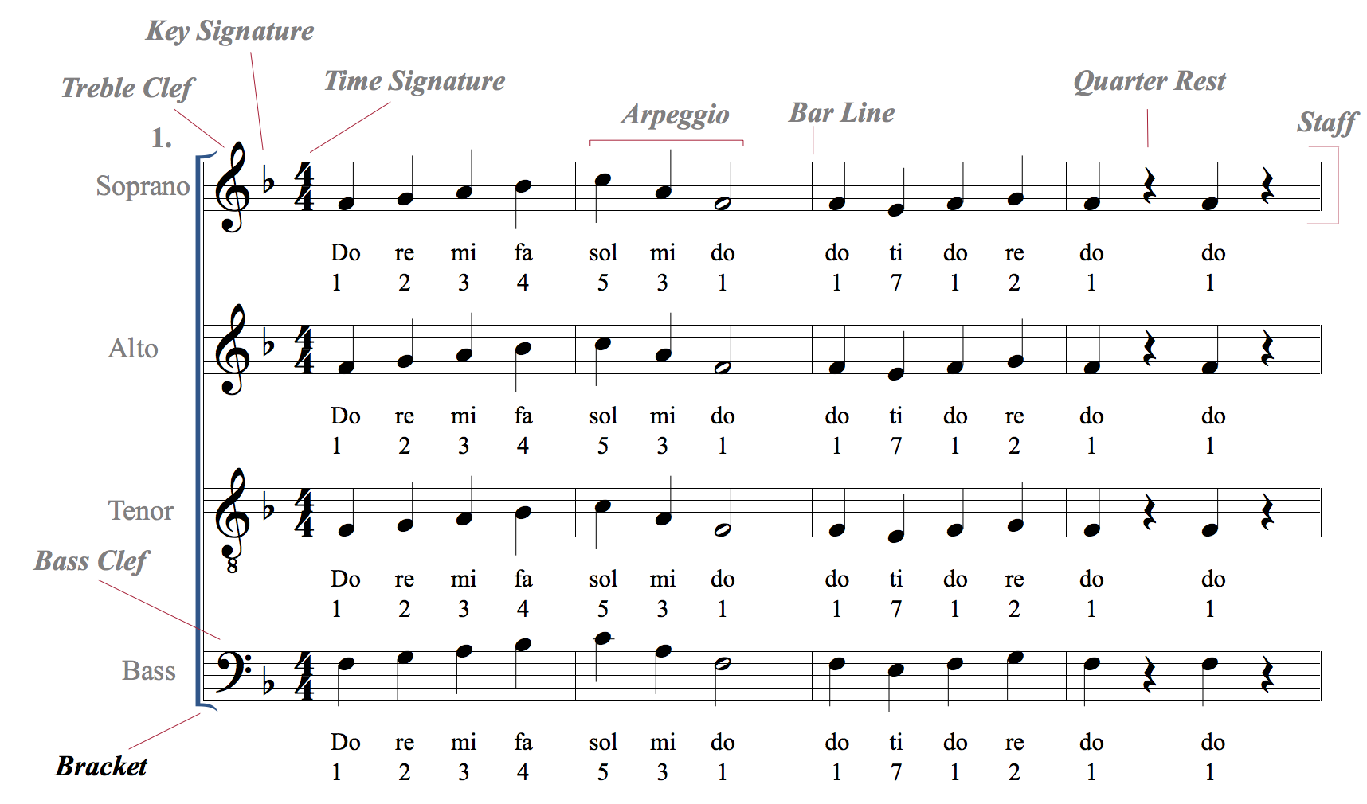
The bracket (or brace) groups together different staves into one system.

Slide 8
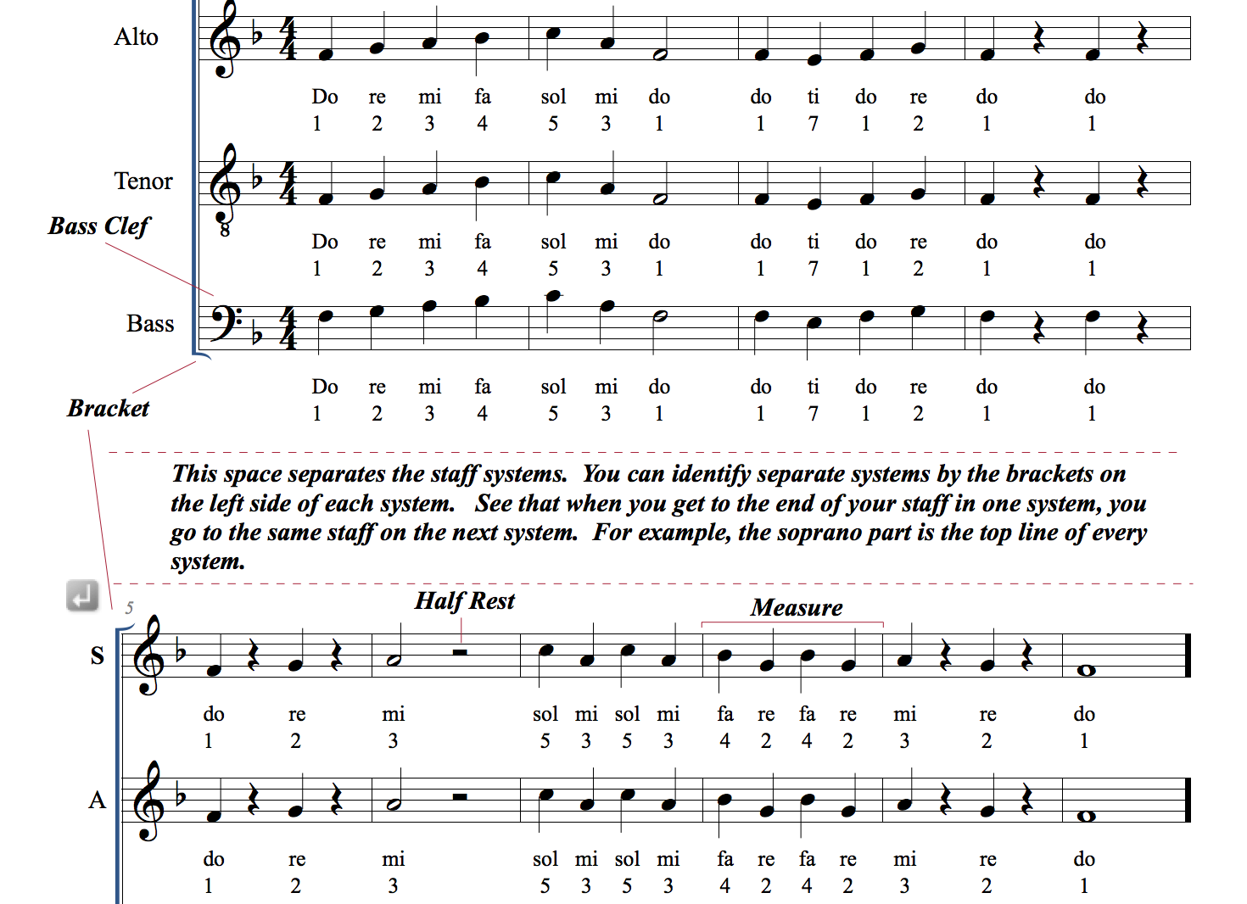
In between two systems, there is usually some open space. Recognizing this space helps you follow your part from one system to the next.
The bracket also helps you recognize each system separately.

Slide 9
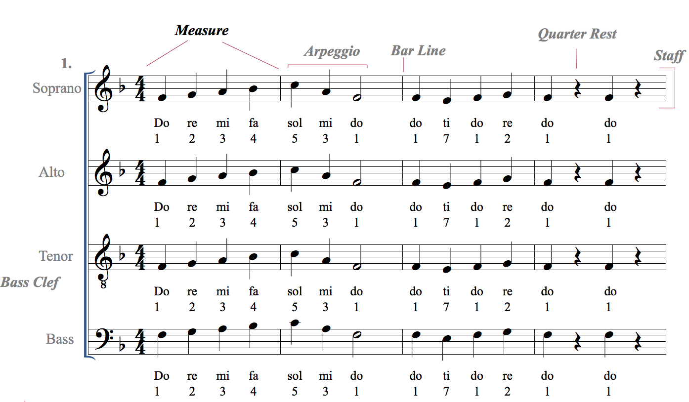
A measure is a segment of time in a piece of music defined by a certain number of beats.

Slide 10
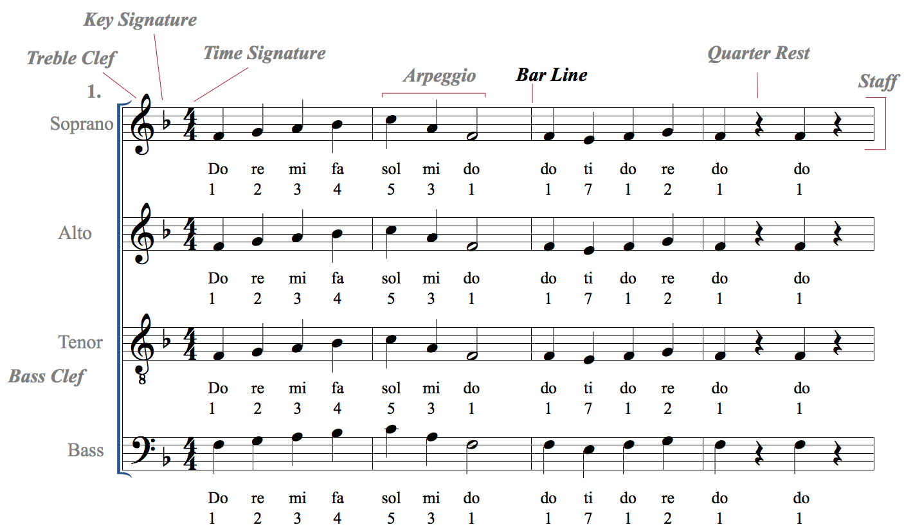
Measures are separated by bar lines.

Slide 11
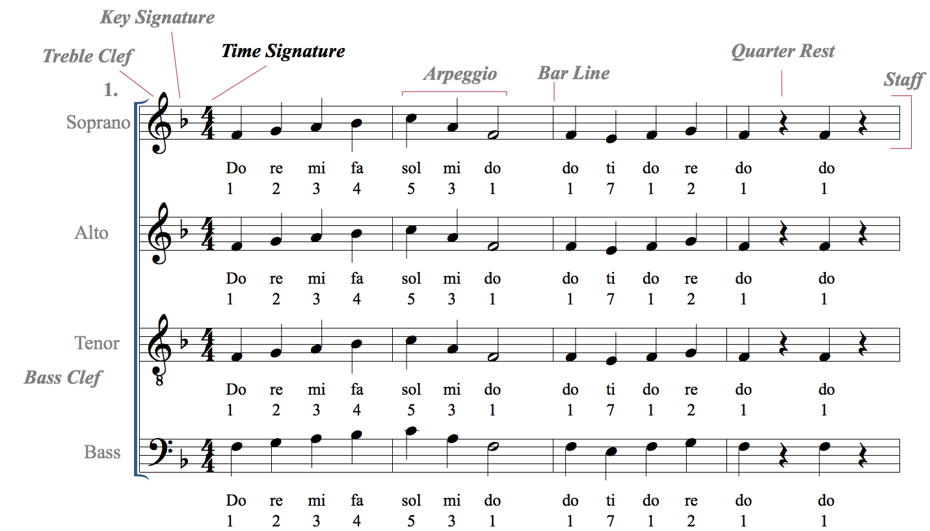
The time signature tells us how many beats are in a given measure.

Slide 12
The top number of a time signature tells us how many beats there are in a measure.
4
4
In this instance, there are four beats in the measure

Slide 13
The bottom number of a time signature tells what kind of note gets the beat.
4
4
In this instance, the quarter note gets the beat

Slide 14
For each time signature, tell how many notes are in a measure and what note value gets the beat.
3
4
2
4
4
4
2
2
4
8
3
8

Slide 15

There are different note values that each have their own duration.
Quarter Notes get 1 beat in 4/4 time

Slide 16
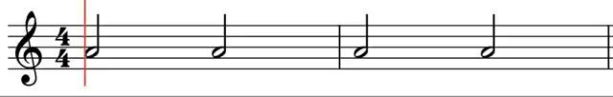
There are different note values that each have their own duration.
Half Notes get 2 beats in 4/4 time

Slide 17
There are different note values that each have their own duration.
Whole Notes get 4 beats in 4/4 time

Slide 18
There are different note values that each have their own duration.
An example with all of these note values

Slide 19
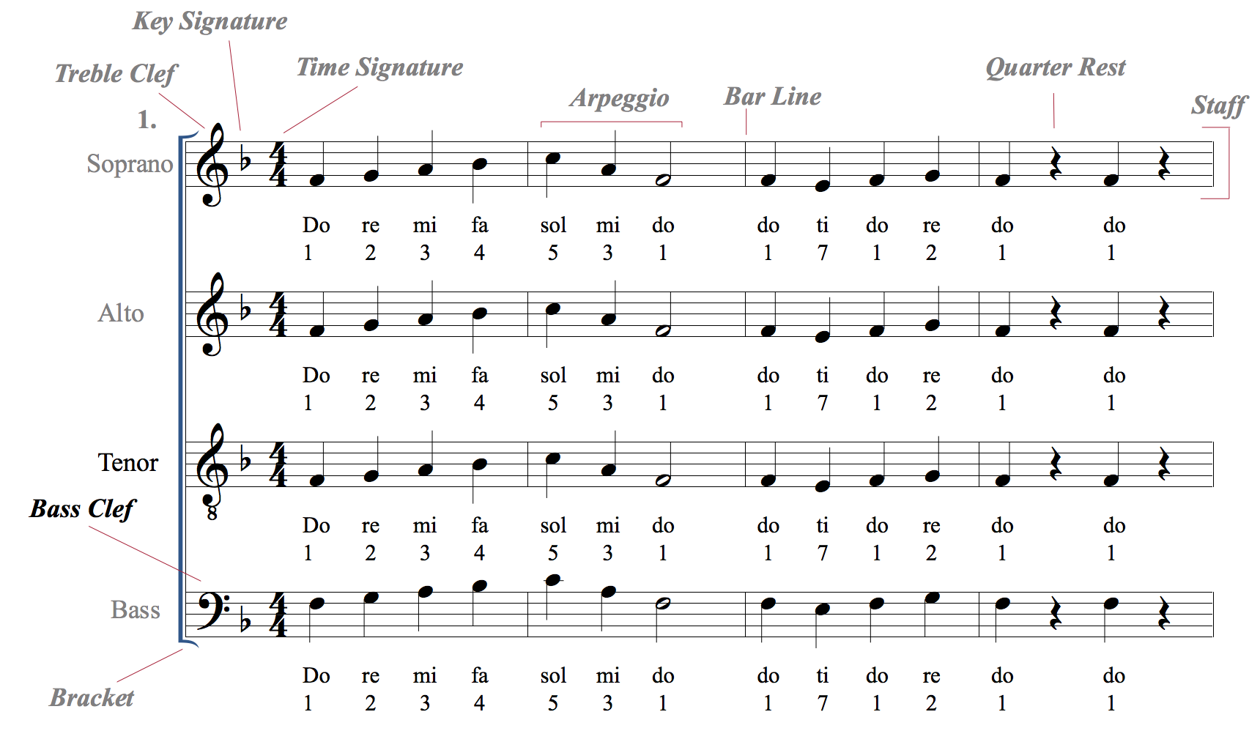
The bass clef is used for lower voices. It centers around the fourth line, F.

Slide 20
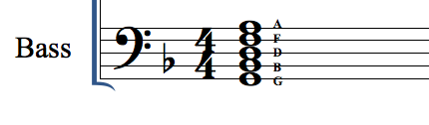
The lines on the bass clef are GBDFA
An easy way to remember this is the acronym
Good Boys Do Fine Always

Slide 21
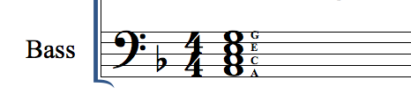
The spaces on the bass clef are ACEG
An easy way to remember this is the acronym
All Cows Eat Grass

Slide 22
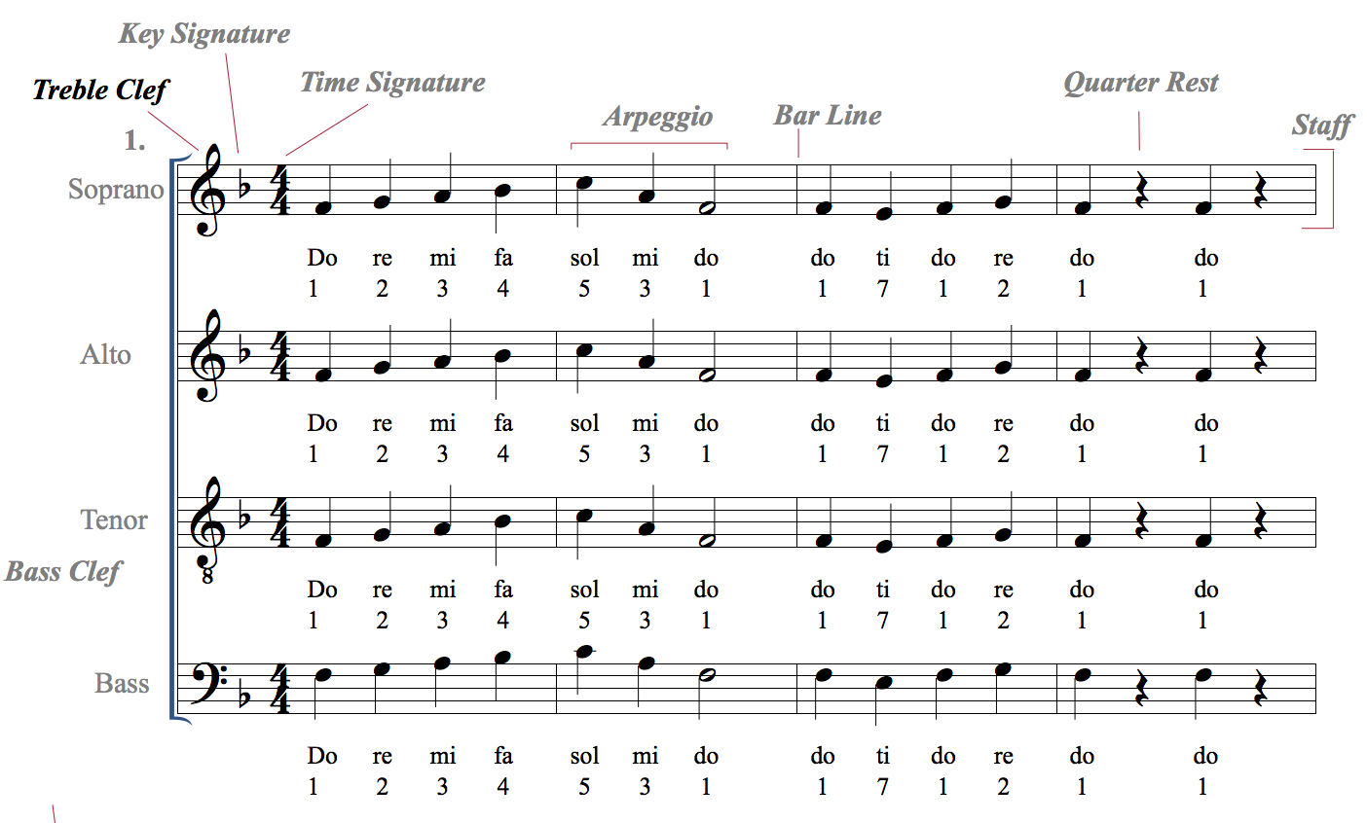
The treble clef is used for higher voices

Slide 23
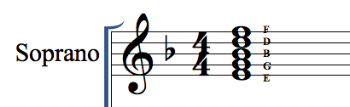
The lines on the treble clef are E G B D F
An easy way to remember this is the acronym
Elvis’ Guitar Broke Down Friday

Slide 24
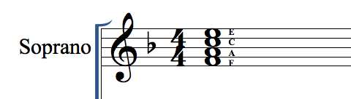
The spaces on the treble clef are F A C E
An easy way to remember this is the word FACE!

Slide 25
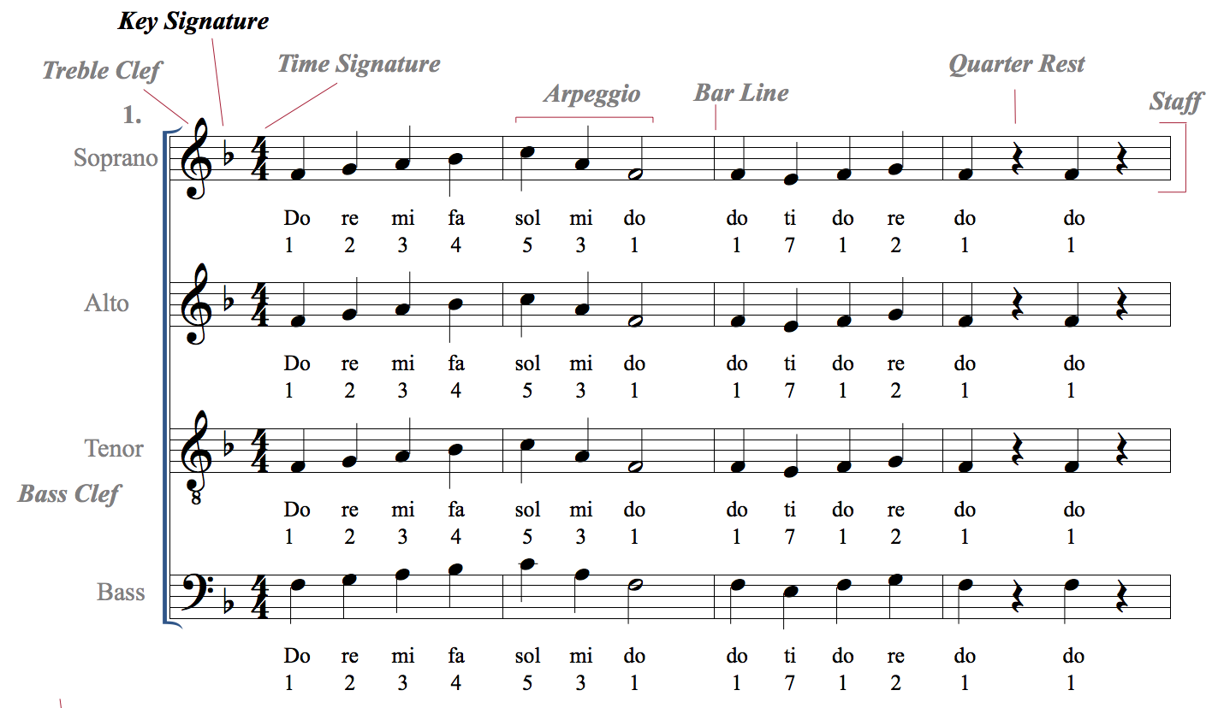
The key signature tells us where the tonal center is. If you use solfege, the tonal center is “do”. If you use numbers, the tonal center is 1.
This is the key of F, one flat.
An easy way to remember that is “One F is F”, as in one flat is the key of F.
You’ll learn more about key signatures in future lessons!

Slide 26
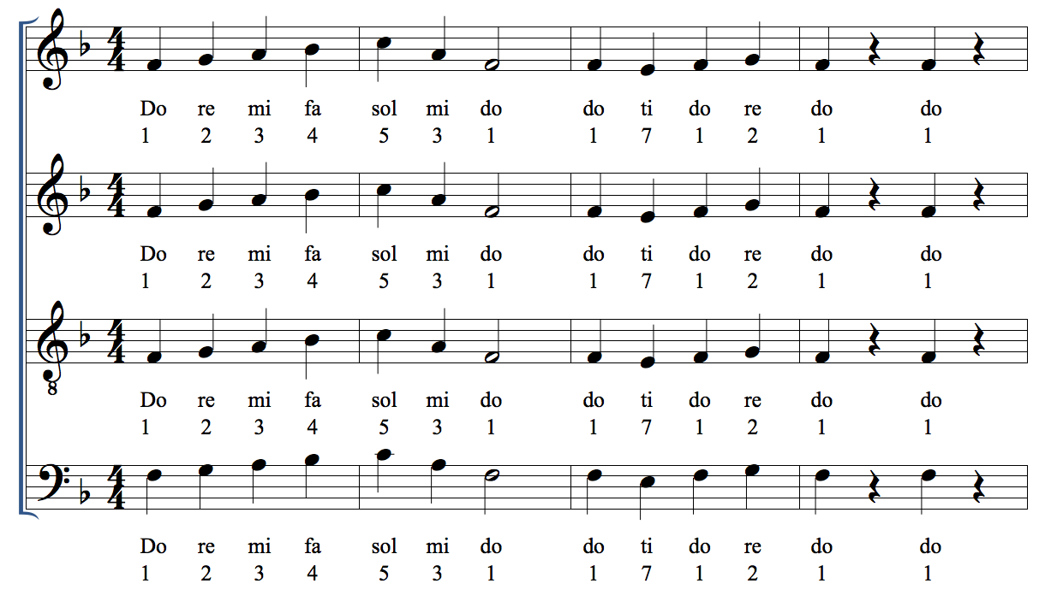

Now let’s practice singing each note in this example slowly, one at a time, out of tempo.

Slide 27
Now let’s practice singing this system a bit faster and in tempo! Make sure you are keeping the beat either in your head or by tapping on your side.

Slide 28
Now record yourself singing this example. You may use the recording to help.

Slide 29
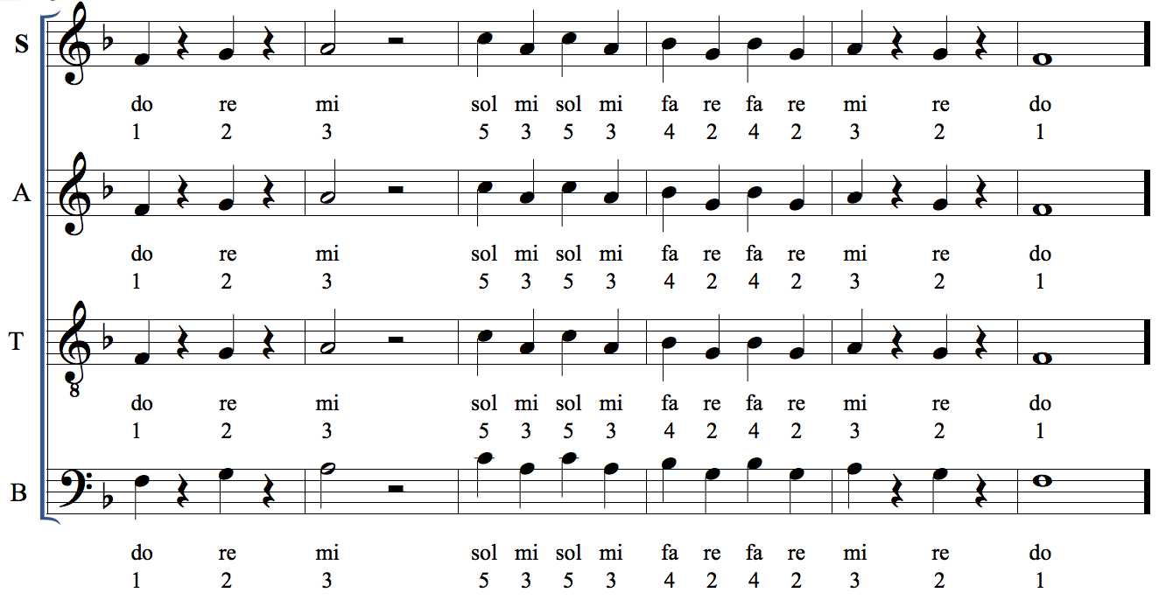
Go on to the next system of music. Practice singing your notes one at a time, then sing it in tempo. This is sightreading example 2.

Slide 30
Record yourself singing this sightreading example 2. You may use the recording to help.

Slide 31
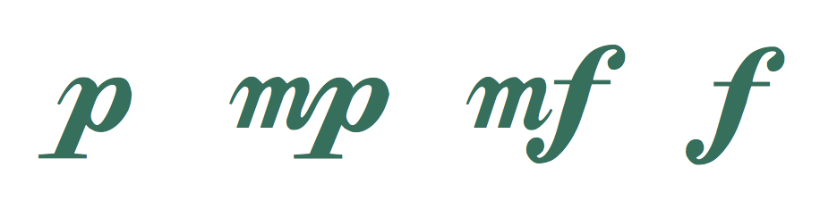
Dynamics are the measurement of volume, or intensity, in music.
piano mezzo piano mezzo forte forte
Soft medium soft medium loud loud

Slide 32
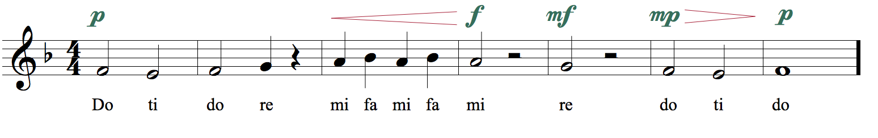
Practice this example with dynamics.
crescendo
decrescendo

Slide 33
Record yourself singing this example. You may use the recording for help.
crescendo
decrescendo

Slide 34
Articulations define the attack and decay of a note.
Legato means to sing or play notes in a smooth and connected manner.
Legato is shown in music with either the word “legato” or a curved line called a slur.
Staccato means to sing or play notes with separation between them.
Staccato is shown in music using a dot above or below a notehead.

Slide 35
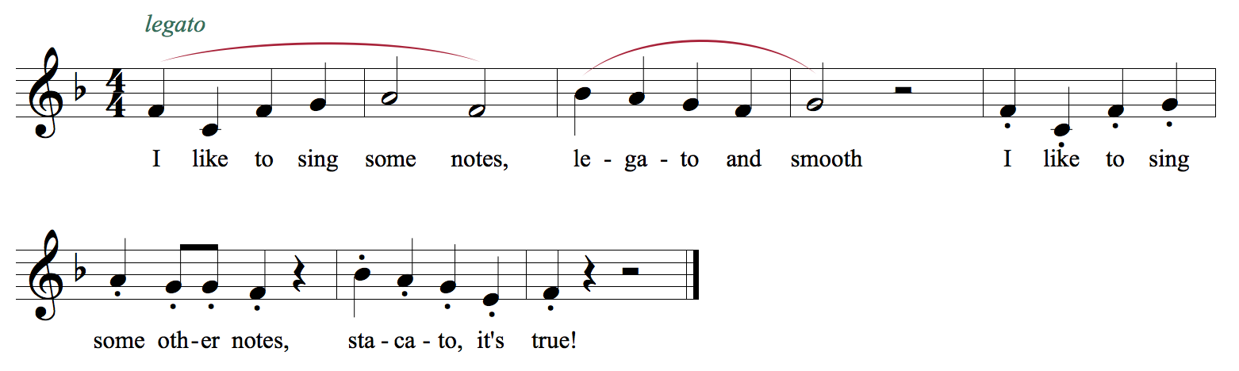
Practice this example using legato and staccato articulations.

Slide 36
Now record yourself singing this example on your own with only the piano playing with you.

