Slide 1
Online Interactive Choir Lessons
Click on this link for the Google Slides Presentation: https://docs.google.com/presentation/d/1uzViVrUjH3jIhegnM6tMCslEw6bYvp4vgbNfGAF8bf8/edit?usp=sharing
Click on this link for the student answer sheet: https://docs.google.com/forms/d/1p3cuZK6LhxtplZuC0oygNfUdy-0cL7E3VIMKeGTxPOw/edit?usp=sharing
YOU WILL NEED TO MAKE A COPY OF THE STUDENT ANSWER FORM BEFORE USING IT. Do not use the form without first making a copy. After making a copy, you will be prompted to reconnect the folder for student submissions. Click “relink”.
I’m always trying to make these lessons better, so please send me feedback and ideas to admin@jdfrizzell.com!

Slide 2
Middle School Choir Primer
Introduction to score reading

Slide 3
The musical alphabet uses the letters A through G
A B C D E F G

Slide 4
The letters continue in either direction.
A B C D E F G
E F G
A B C D E F G
A B C

Slide 5
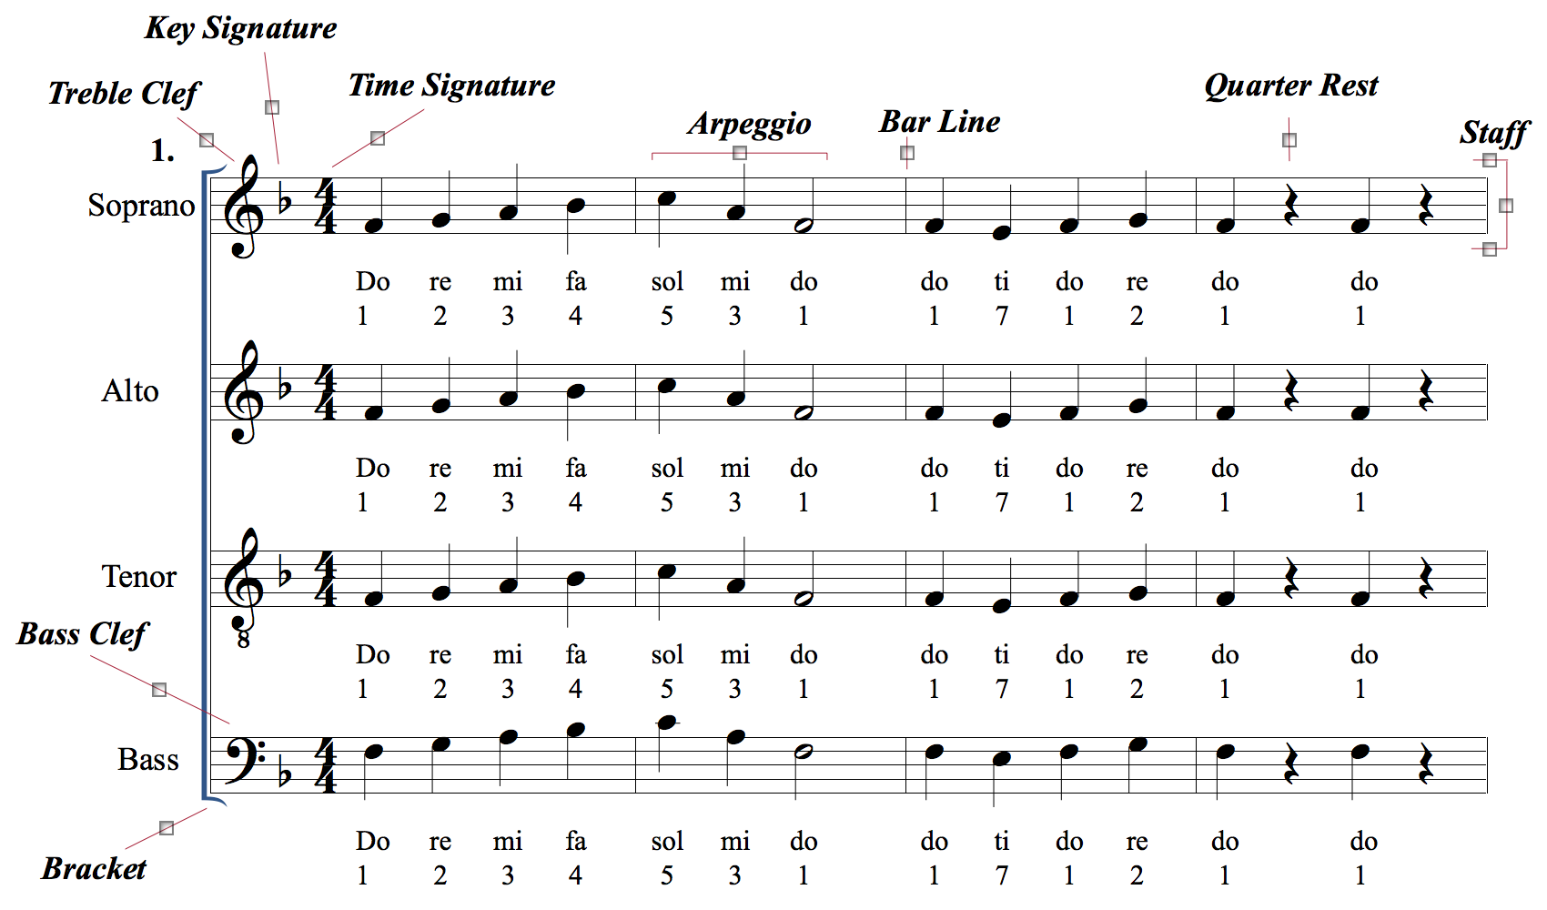
This is what the beginning of most of your music will look like.

Slide 6
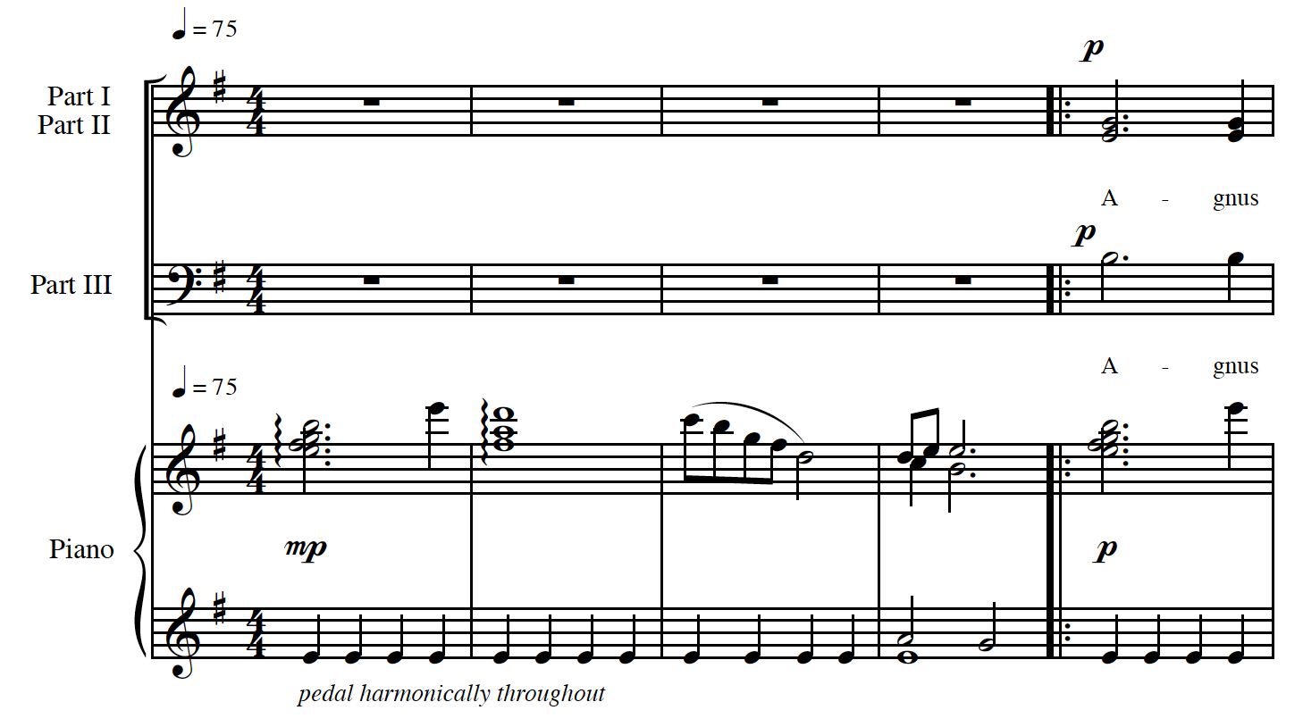
Sometimes it may look like this. Notice there are two parts on one staff-- part I would sing the top note and part II would sing the bottom. Part III has a staff to themselves.
There’s also a piano part that accompanies the choir.

Slide 7
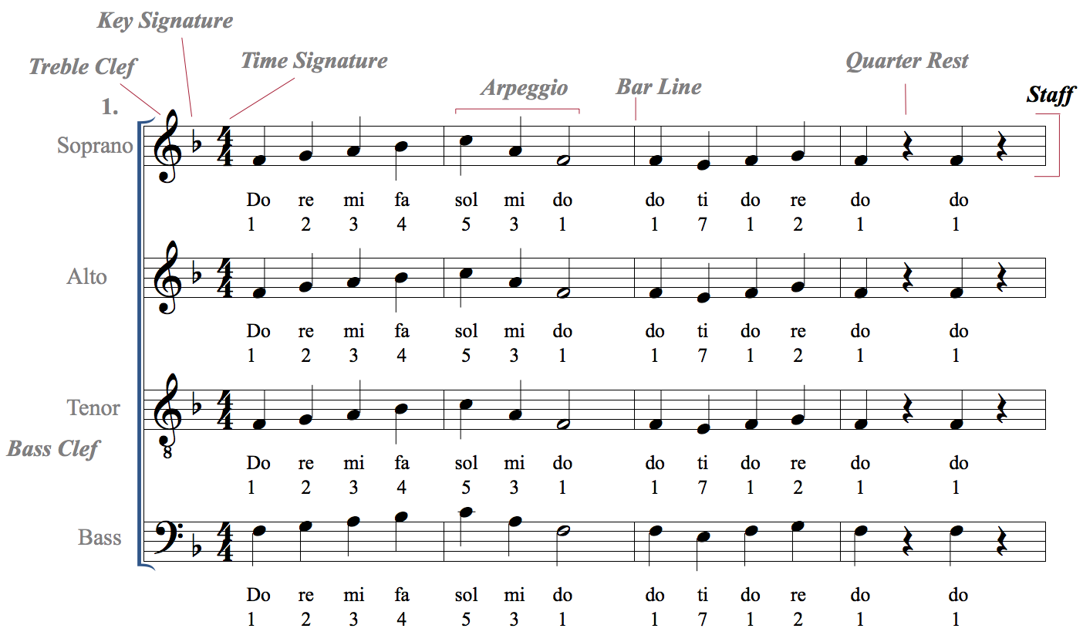
The staff is a set of five horizontal lines and four spaces. Each line or space holds a different note, or pitch.
Multiple staffs are called
staves

Slide 8
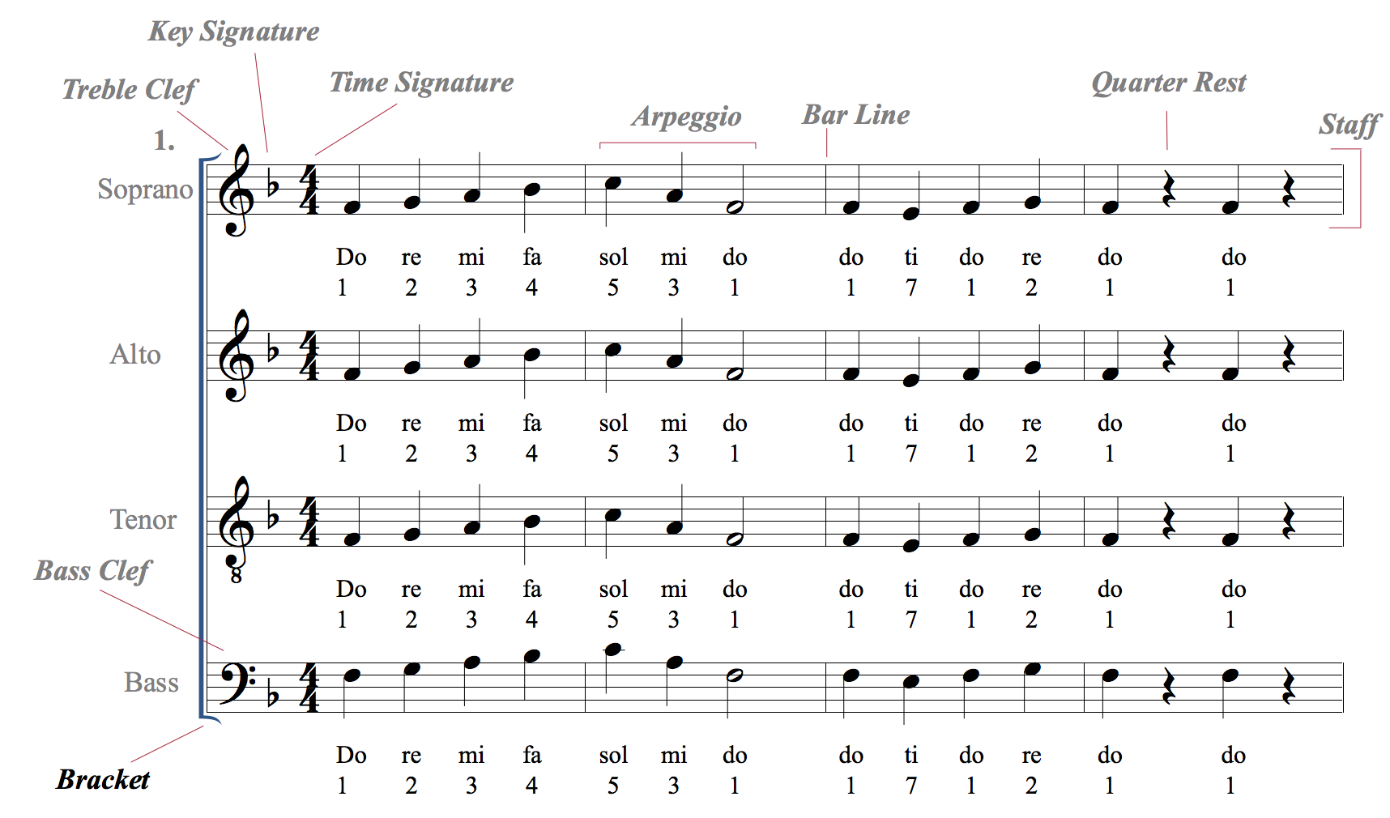
The bracket (or brace) groups together different staves into one system.

Slide 9
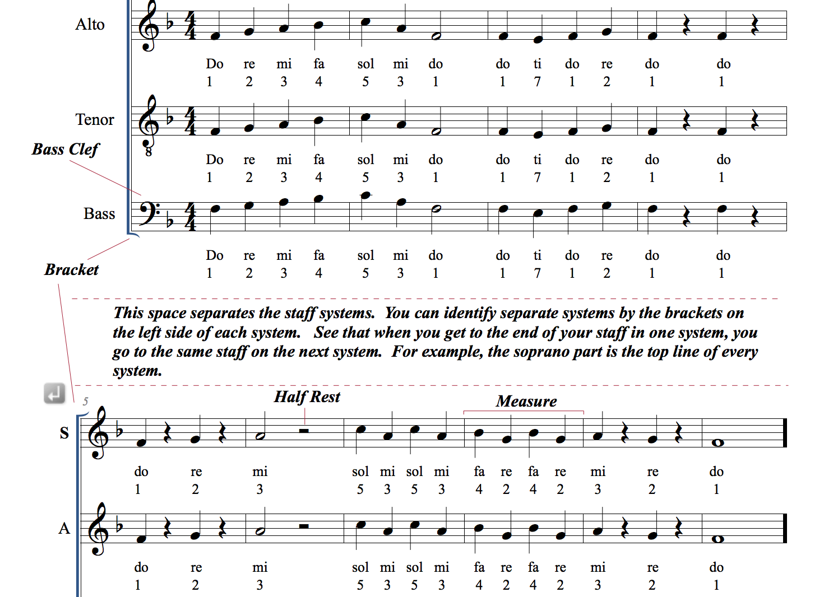
In between two systems, there is usually some open space. Recognizing this space helps you follow your part from one system to the next.
The bracket also helps you recognize each system separately.

Slide 10
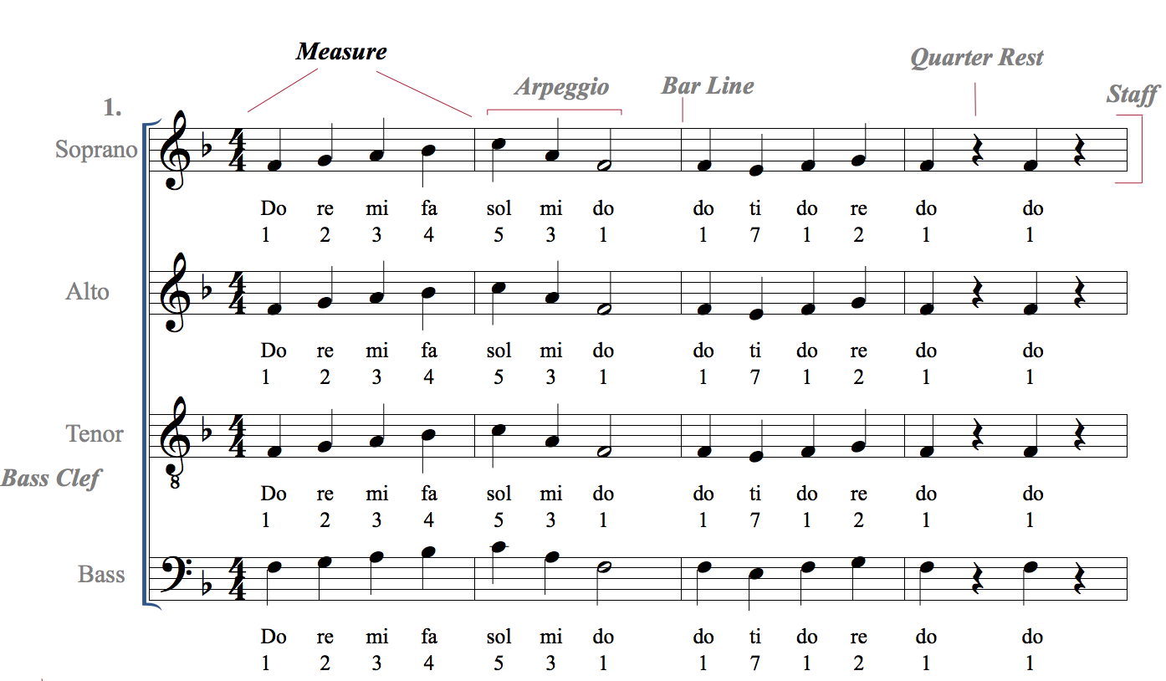
A measure is a segment of time in a piece of music defined by a certain number of beats.

Slide 11
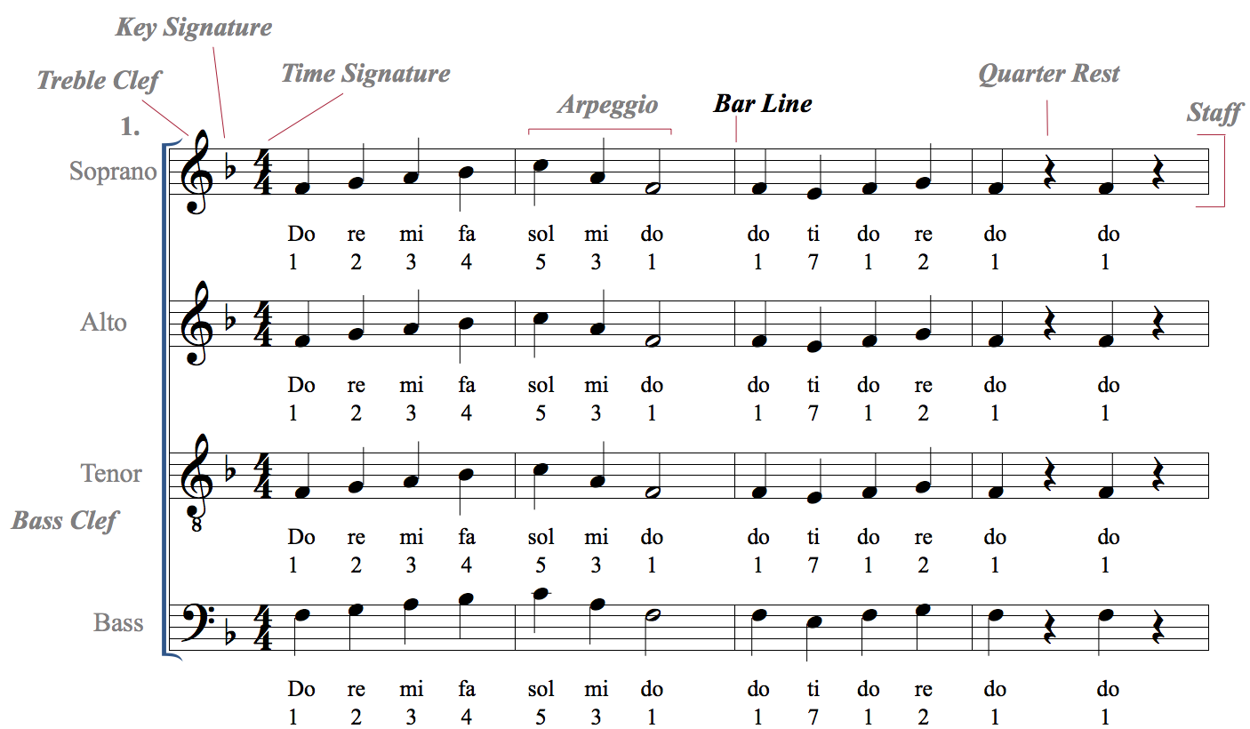
Measures are separated by bar lines.

Slide 12
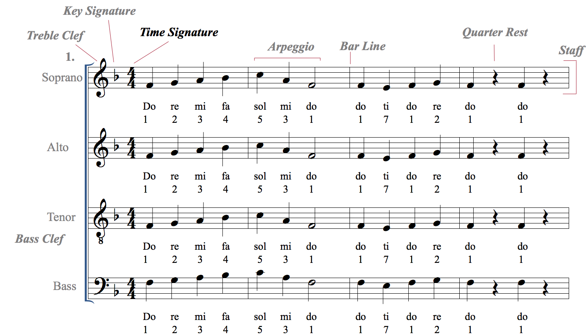
The time signature tells us how many beats are in a given measure.

Slide 13
The top number of a time signature tells us how many beats there are in a measure.
4
4
In this instance, there are four beats in the measure

Slide 14
The bottom number of a time signature tells what kind of note gets the beat.
4
4
In this instance, the quarter note gets the beat

Slide 15
For each time signature, tell how many notes are in a measure and what note value gets the beat.
3
4
2
4
4
4
2
2
4
8
3
8

Slide 16
There are different note values that each have their own duration.
Quarter Notes get 1 beat in 4/4 time

Slide 17
There are different note values that each have their own duration.
Half Notes get 2 beats in 4/4 time

Slide 18
There are different note values that each have their own duration.
Whole Notes get 4 beats in 4/4 time

Slide 19
There are different note values that each have their own duration.
An example with all of these note values

Slide 20
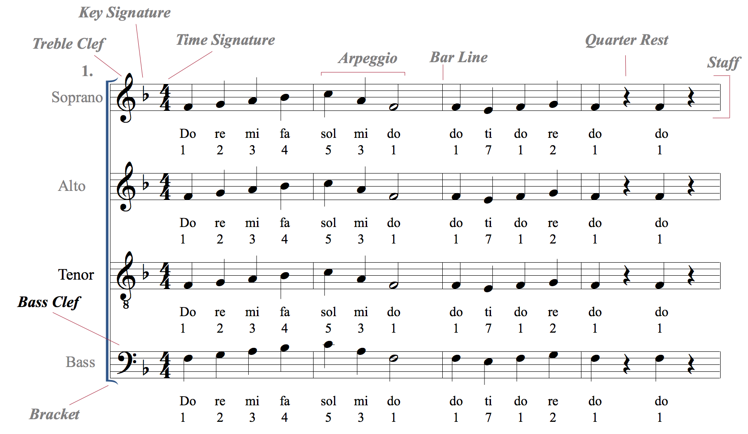
The bass clef is used for lower voices. It centers around the fourth line, F.

Slide 21
The lines on the bass clef are GBDFA
An easy way to remember this is the acronym
Good Boys Do Fine Always

Slide 22
The spaces on the bass clef are ACEG
An easy way to remember this is the acronym
All Cows Eat Grass

Slide 23
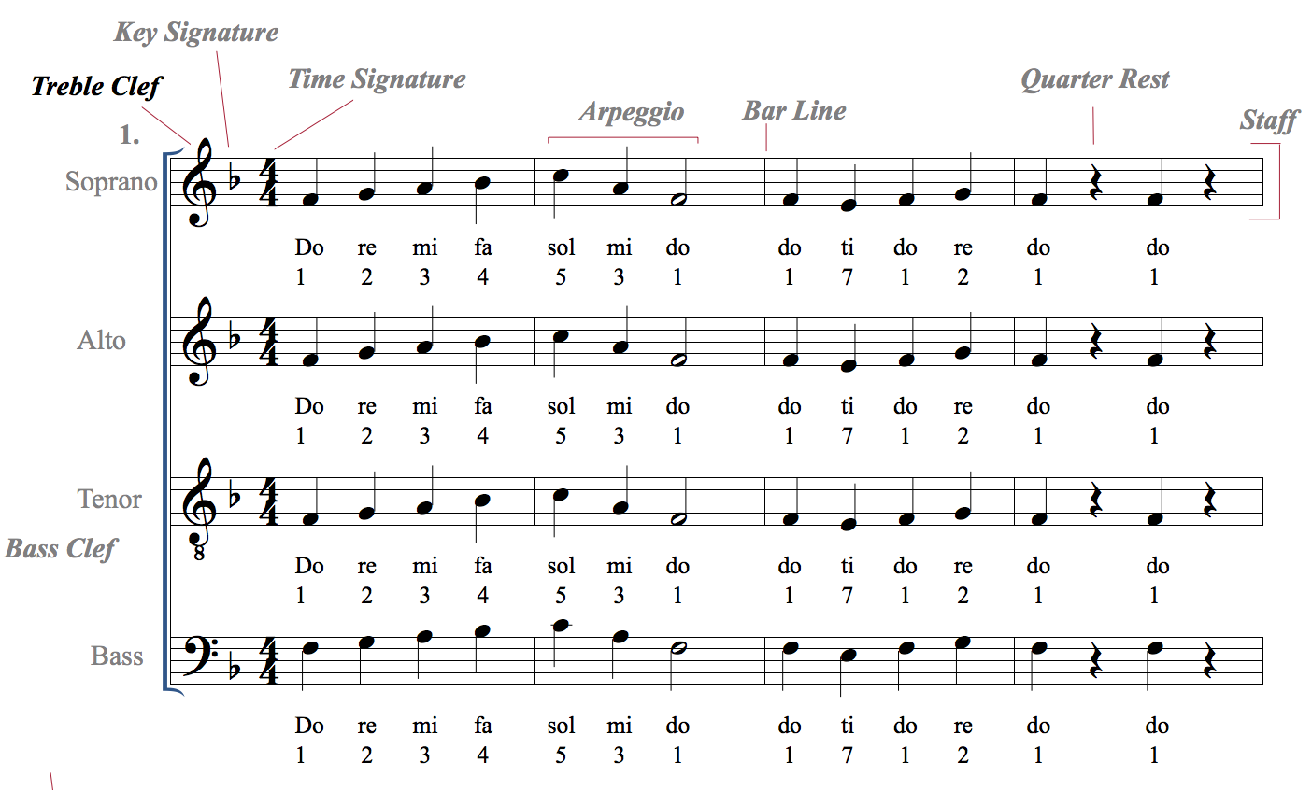
The treble clef is used for higher voices

Slide 24
The lines on the treble clef are E G B D F
An easy way to remember this is the acronym
Elvis’ Guitar Broke Down Friday

Slide 25
The spaces on the treble clef are F A C E
An easy way to remember this is the word FACE!

Slide 26
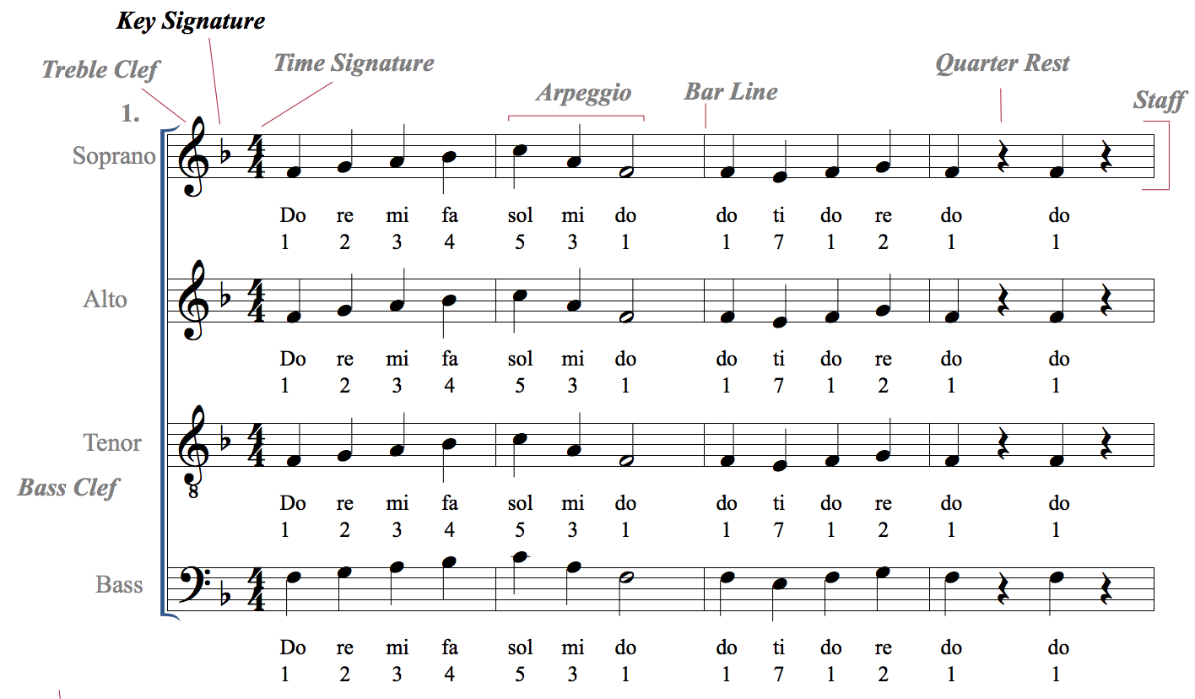
The key signature tells us where the tonal center is. If you use solfege, the tonal center is “do”. If you use numbers, the tonal center is 1.
This is the key of F, one flat.
An easy way to remember that is “One F is F”, as in one flat is the key of F.
You’ll learn more about key signatures in future lessons!

Slide 27
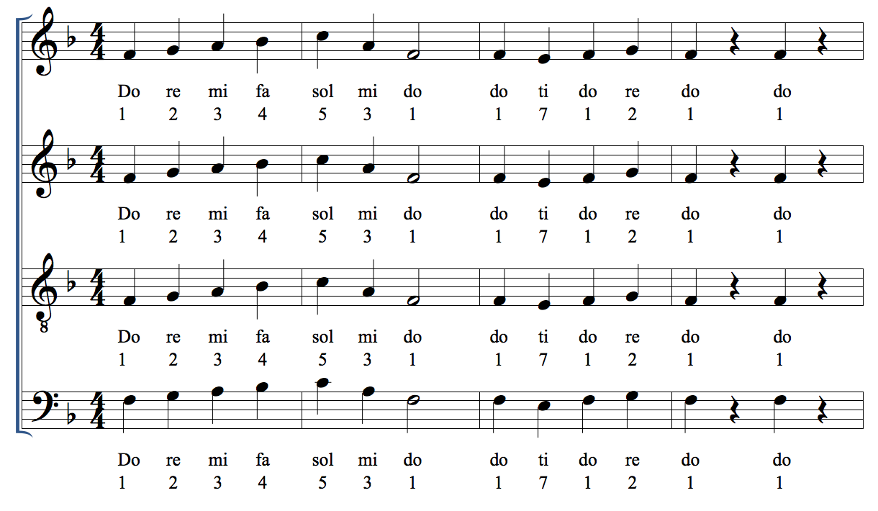
Now let’s practice singing each note in this example slowly, one at a time, out of tempo.

Slide 28
Now let’s practice singing this system a bit faster and in tempo! Make sure you are keeping the beat either in your head or by tapping on your side.

Slide 29
Now record yourself singing this example. You may use the recording to help.

Slide 30
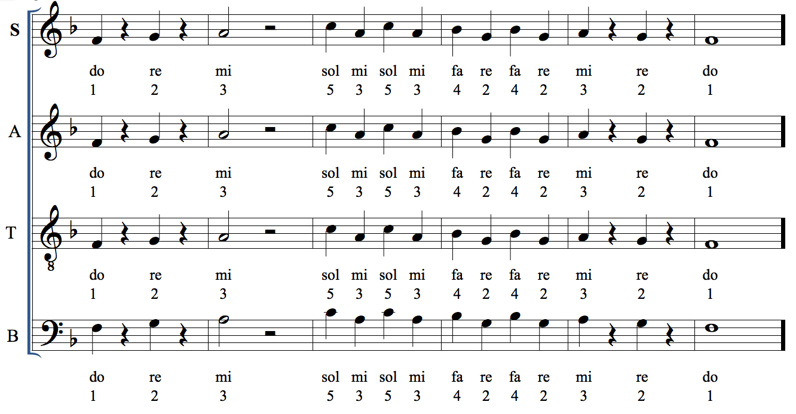
Go on to the next system of music. Practice singing your notes one at a time, then sing it in tempo. This is sightreading example 2.

Slide 31
Record yourself singing this sightreading example 2. You may use the recording to help.

Slide 32
Dynamics are the measurement of volume, or intensity, in music.
piano mezzo piano mezzo forte forte
Soft medium soft medium loud loud

Slide 33
Practice this example with dynamics.
crescendo
decrescendo

Slide 34
Record yourself singing this example. You may use the recording for help.
crescendo
decrescendo

Slide 35
Articulations define the attack and decay of a note.
Legato means to sing or play notes in a smooth and connected manner.
Legato is shown in music with either the word “legato” or a curved line called a slur.
Staccato means to sing or play notes with separation between them.
Staccato is shown in music using a dot above or below a notehead.

Slide 36
Practice this example using legato and staccato articulations.

Slide 37
Now record yourself singing this example on your own with only the piano playing with you.

