Slide 1
Interactive Online Choir Lessons

Slide 2
Student Answer Sheet
Interactive Sheet Music on Noteflight
PDF of Sheet Music

Slide 3
Weep, O Mine Eyes
Composed by John Bennet
Lesson by Dr. J.D. Frizzell

Slide 4
Background
Lesson # 1
Includes Sections on: The Composer The Geographical Region
The Musical Stylistic Period
The Composition

Slide 5
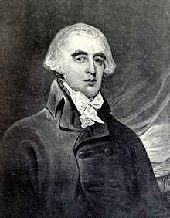
About the Composer
Hardly anything is known about the life of English Renaissance composer John Bennet. He was born into a wealthy family in the town of Abingdon, which is just south of Oxford in England. As a choirboy, he began learning about music at a very young age. His high position in local society allowed him to write music for nobles and aristocracy. Bennet even wrote a piece for Queen Elizabeth.

Slide 6
Oxfordshire, England
Courtesy of YouTube

Slide 7
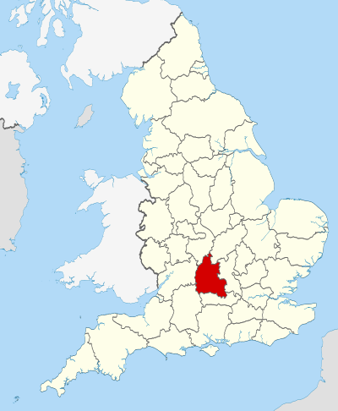
The English Madrigal
The English madrigal was a part song for multiple voices written during the Renaissance period. The number of voices in a madrigal ranged from 2-8. Madrigals were secular in nature, meaning that the texts were not religious.
Oxfordshire, England

Slide 8
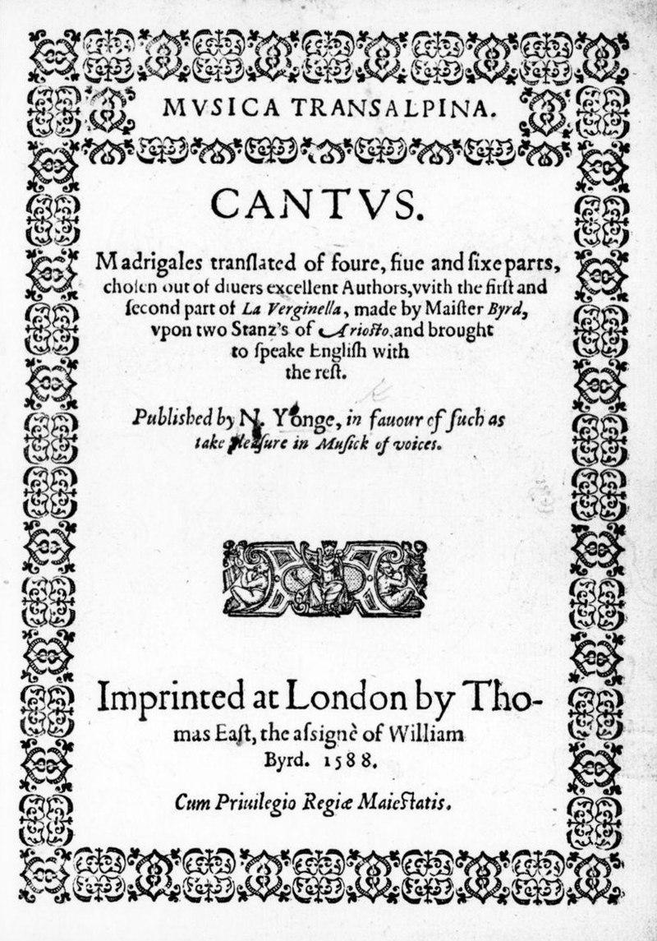
The English Madrigal
Madrigals originated in Italy in the early 16th century. They became popular after Nicholas Yonge published Musica Transalpina, a collection of Italian madrigals with English translations, in 1588.
Musica Transalpina

Slide 9
The Renaissance Period
1450-1600
Medieval Period (800-1450)
Renaissance Period (1450-1600)
Baroque Period (1600-1750)
Classical Period (1750-1820)
Romantic Period (1820-1910)
Modern Period (1910-present)

Slide 10
The Renaissance Period
Courtesy of YouTube

Slide 11
The Renaissance Period Musical Characteristics
Music based on modes Modes are types of scales with unique melodic characteristics. There were no keys or key signatures yet.
Use of polyphony Polyphony is a texture that combines multiple voices, each singing an independent melodic line.
More focus on harmony and chords Harmony is the result of two or more notes sounding simultaneously.
Rise in the composition of secular music The printing press allowed for easier distribution of secular compositions, those that are not religious in nature.

Slide 12
The Composition
Weep O Mine Eyes is a madrigal written for 4 voices, a cappella. A cappella is an Italian term that literally means “in the style of the chapel”. Today, we have come to know this as meaning music without instruments. It was published in Bennet’s collection, Madrigalls to Fovre Voyces in 1599.
Weep, o mine eyes, and cease not,
alas, these your springtides me thinks increase not.
O when, O when begin you
to swell so high that I may drown me in you?

Slide 13
Music Theory
Lesson # 2 and Lesson #3
Includes These Topics:
Score Organization Tonal Centers/Key Signatures
Melody and Countermelody
Melodic Fragmentation Sequences

Slide 14
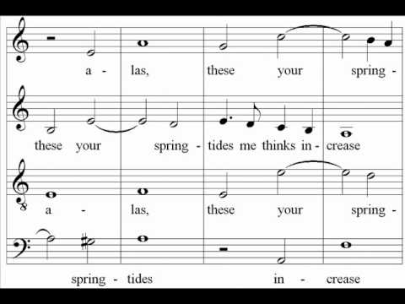
Music Theory
Listen to a performance of Weep, O Mine Eyes as performed by The Cambridge Singers. Follow along with the score.
Courtesy of YouTube

Slide 15
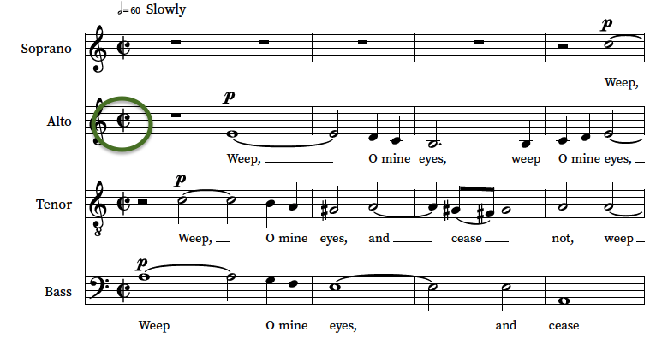
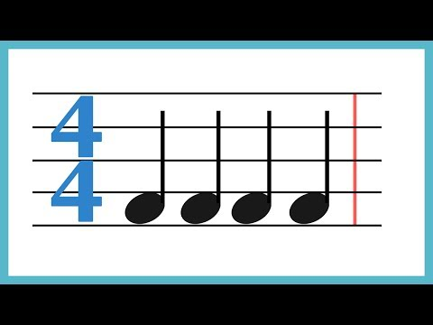
Music Theory
Take a look at the time signature of the piece. It is a letter C with a vertical line through it. This is called cut time. Cut time is another way to notate a 2/2 time signature.
Need a refresher on time signatures? Watch this!
Courtesy of YouTube

Slide 16
Music Theory
In cut time, how many beats are in the measure and what note value gets the beat?
The bass part enters on an A.
The tenor part enters on a C.
What note does the alto part enter on?

Slide 17
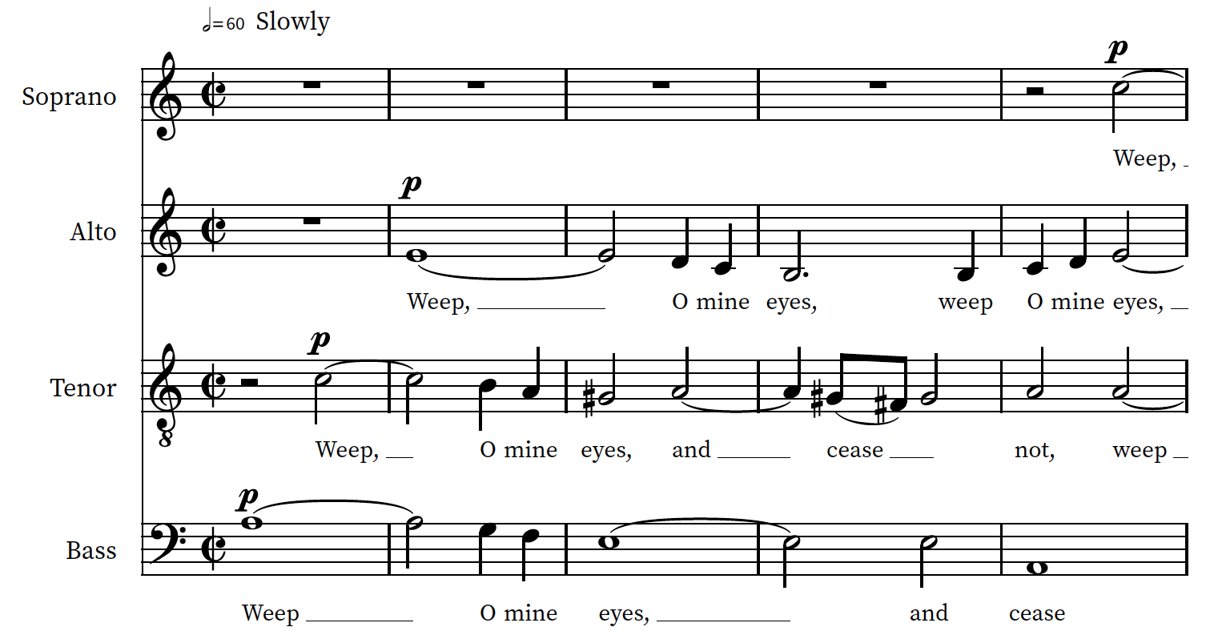
Music Theory
One often-used technique in the Renaissance period is the point of imitation.
A point of imitation is a single melodic idea sung in succession by various parts. The successive voices are often similar to the original melody, but altered slightly by pitch and rhythm.

Slide 18
Music Theory
The first point of imitation starts in the bass part with succeeding entrances from the tenor, alto, and then finally the soprano after 5 measures.

Slide 19
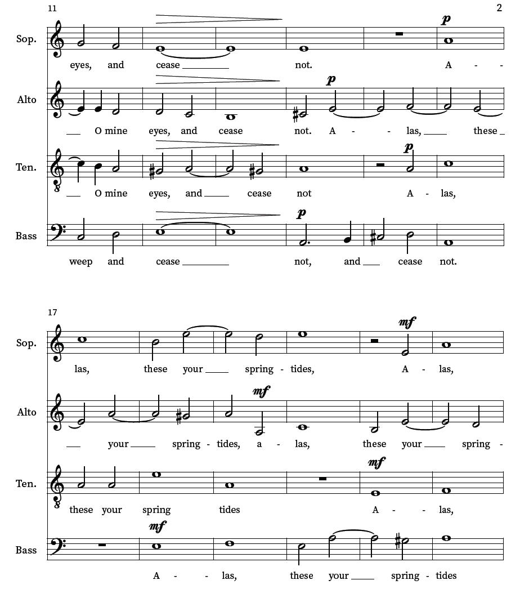
Music Theory
Where does the second point of imitation begin on page 2?
What voice part starts singing this second point of imitation last?

Slide 20
Music Theory
Dynamics were not written into music from the Renaissance period. The dynamics in this and any other Renaissance score are editorial markings, which means the editor added them based on their best knowledge of the performance practice of the time.

Slide 21
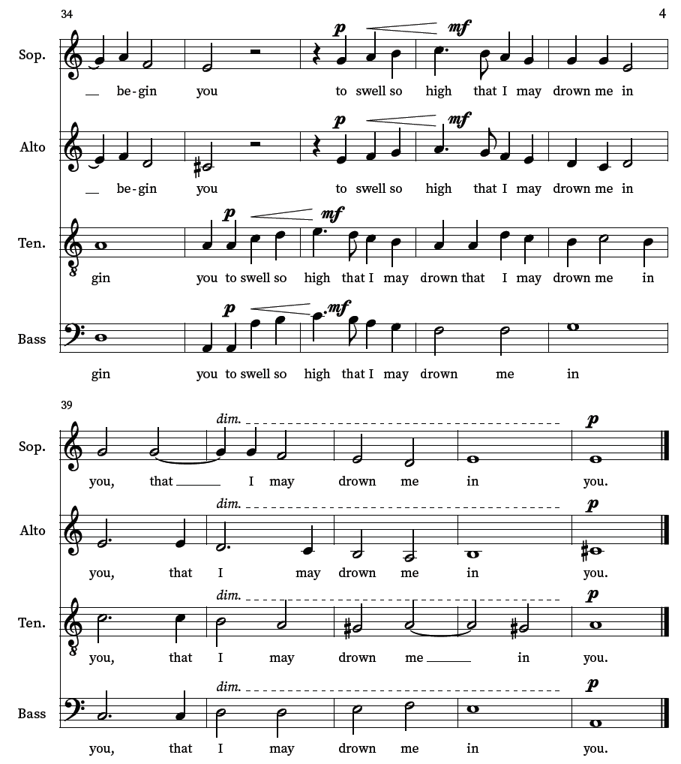
Music Theory
Text painting is when a composer sets the music in a way that makes it reflect the meaning of the text in some way. Sometimes, these are more subtle, but often they are quite obvious. Such an instance of text painting occurs here in page 4.
Can you describe the text painting on page 4? What words are the voices singing? How does that reflect the text?

Slide 22
Vocal Technique
Lesson # 4

Slide 23
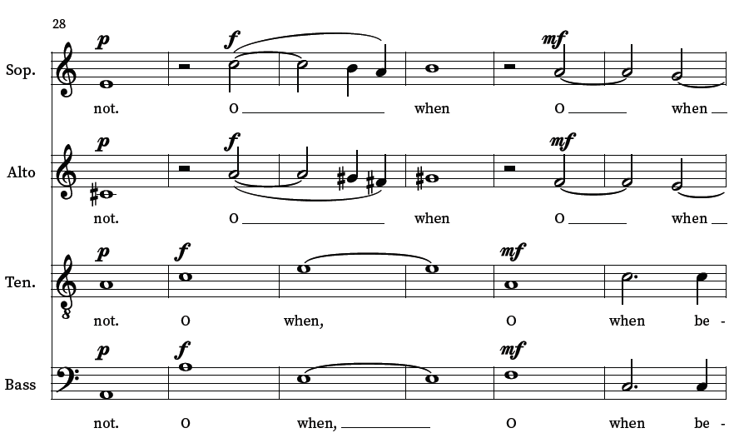
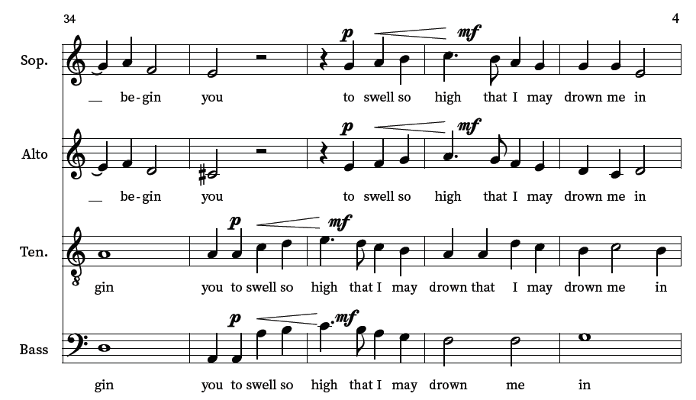
Vocal Technique
Practice singing your part at measure 29-35. You may use the interactive Noteflight score to help you pick out and learn your part if you would like.
Keys to success:
Focus on good breath support.
Breathe in on the vowel “O”.
Use a pure “O” vowel without any diphthongs (two or more vowels blended together).
“When” starts with an “oo” vowel and moves quickly to an open “eh” vowel.

Slide 24
Vocal Technique
Now practice singing the next phrase “to swell so high” from measure 35-43.
Keys to success:
A crescendo through “to swell so high”
An open “Ah” vowel on the word “high” before a quick movement to the “ee” vowel.
A lot of crisp initial and ending consonants
A quarter note breath after “you”
A flipped “r” on “drown”
Avoid closing to the “n” on the word “in”.

Slide 25
Vocal Technique
Once you have finished practicing, please record yourself singing this line. You may sing along with the recording or with the noteflight track if it is helpful. Be patient-- it may take up to 15 minutes or so to get it!

Slide 26
Listening and Evaluating
Lesson # 5

Slide 27
Listening and Evaluating
Listen to these two other English madrigals.
Pay attention to the following characteristics:
Texture
Time signature
Lyrics
Tempo
Difficulty

Slide 28
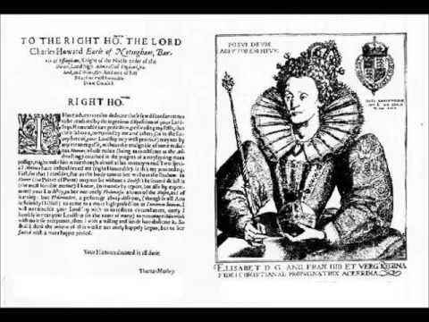
Listening and Evaluating
All Creatures Now Are Merry Minded, John Bennet Courtesy of YouTube

Slide 29
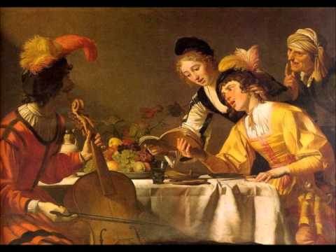
Listening and Evaluating
Come Away, Sweet Love by Thomas Greaves
Sung by The Cambridge Singers Courtesy of YouTube

Slide 30
Listening and Evaluating
How are these two English Madrigals similar to Weep, O Mine Eyes?
How are they different from Weep, O Mine Eyes?

