Slide 1

Interactive Online Choral Lessons
Here is the link to the set of lessons on Google Slides:
https://docs.google.com/presentation/d/11OPzVGjqEeOaoah38lHakwIworXaXEggPjoibWpX6Xg/edit?usp=sharingcru
Here is the link to the student answer sheet (please copy it as soon as you open it):
https://docs.google.com/forms/d/1LC-jJiz1W9VY9zh3hXR3xniIbdJrVAQuBn4OunIbbJQ/edit?usp=sharing
Thank you for downloading my set of lessons! The license that comes with the set of lessons includes use by you and any other teachers or students at your school. Please do not share this with others beyond your school.
Suggestions for Successful Implementation
· Use whatever version (Powerpoint, PDF, or Google) will work best with your computer and streaming service. The most seamless experience is going to be the google slides version.
· If you want, students can also view the PPT, PDF, or google slide on their device, too.
· I’ve designed the lessons to be as turnkey as possible, but they aren’t meant to just be given to students without a teacher leading them through. Ideally, some teacher lecture and discussion will get the best results.
· I’ve also designed the lessons to work either as completely virtual, hybrid, or in-person.
· BE SURE TO MAKE A COPY OF THE GOOGLE ANSWER SHEET. Do not send the original to your students, or you will be sharing data and answers with every other teacher using this. Details for how to do that are on the actual student answer sheet itself.
If you have questions, please e-mail admin@jdfrizzell.com

Slide 2
cruelly, love
Music by J.D. Frizzell
Poetry by E.E. Cummings

Slide 3

Composer Background
The composer of this piece is Dr. J.D. Frizzell. He is currently the Director of Fine Arts at Briarcrest Christian School outside of Memphis, Tennessee.
One interesting fact about Dr. Frizzell is that he didn’t start studying music at all until the age of 15 when he joined choir during his sophomore year of high school.
In addition to teaching and composing, Dr. Frizzell is a leader in the contemporary a cappella field. He is co-author of two books, serves as President of the A Cappella Education Association, and directs SONY recording artists Briarcrest OneVoice.

Slide 4
Composer Style
Dr. Frizzell’s compositional style combines influences from well-known 20th and 21st century composers, including Morten Lauridsen, Gerald Finzi, Eric Whitacre, and Frank Martin.
Notable stylistic elements include:
A fluid tonal center
Common tone modulations
Intricate piano parts
Use of aleatoric sections
Speech-like rhythms
Free use of dissonance

Slide 5
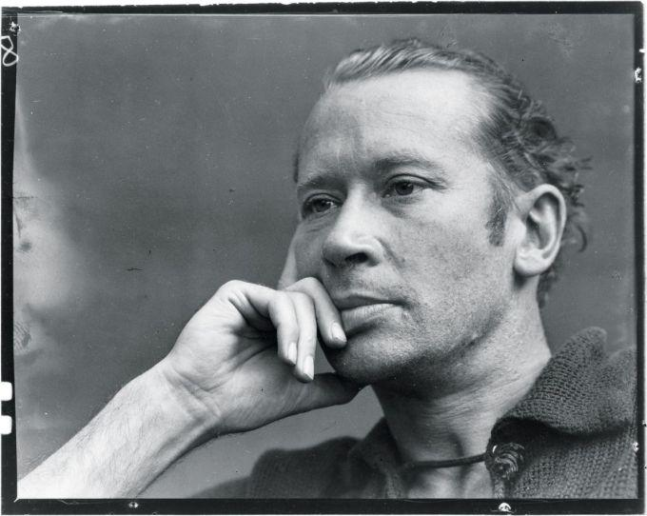
Poet Background
Edward Estlin Cummings was an American poet (1894-1962).
One of the most influential poets of the 20th century, Cummings wrote over 2,900 poems.
His predominant style is modernist free-form poetry.
His poetry is known for idiosyncratic syntax, lower case usage, and compound words.

Slide 6
Examples of Stylistic Elements of E.E. Cummings
idiosyncratic syntax
and it’s you are whatever a moon has always meant
and whatever a sun will always sing is you
-“[i carry your heart with me(i carry it in]”
lower case usage
i carry your heart with me(i carry it in
my heart)i am never without it(anywhere
-“[i carry your heart with me(i carry it in]”

Slide 7
Examples of Stylistic Elements of E.E. Cummings
Compound words
I occasionally feel vague how
vague i don’t know tenuous Now-
spears and The Then-arrows making do
our mouths something red,something tall
-”let’s live suddenly without thinking”

Slide 8
cruelly, love
cruelly,love
walk the autumn long;
the last flower in whose hair,
they lips are cold with songs
for which is
first to wither,to pass?
shallowness of sunlight
falls,and cruelly,
across the grass
Comes the
moon
love,walk the
autumn
love,for the last
flower in the hair withers;
thy hair is acold with
dreams,
love thou art frail
—walk the longness of autumn
smile dustily to the people,
for winter
who crookedly care.

Slide 9
Discussion Prompt
Analyze the poem “cruelly, love”.
What aspects of E.E. Cummings’ style do you see reflected in this poem? Where and how? Cite specific examples.

Slide 10

Critical Listening
Listen to the piece in its entirety performed by a young high school choir.
What are some aspects of the performance the choir did well?
What are some aspects of the performance in which the choir could improve?

Slide 11
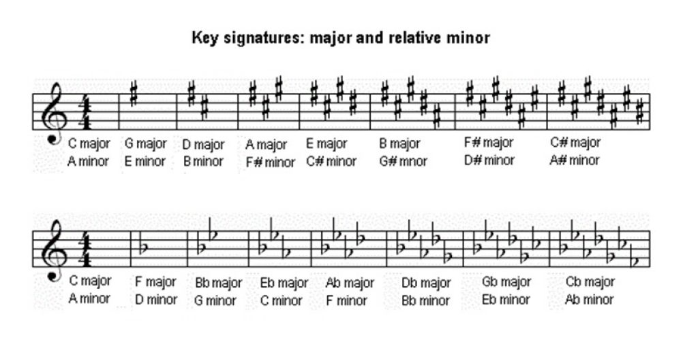
A Key Signature defines the tonal center of a piece of music.

Slide 12
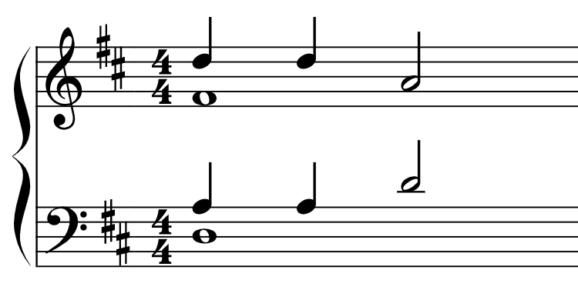
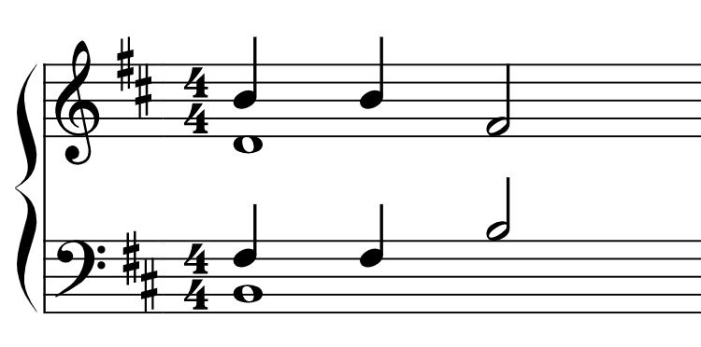
We can usually tell if a section of music is in major or minor based on the first and/or last chords of that section. If it centers around the tonic (scale degree 1) it is usually major. If it centers around the submediant (scale degree 6), it is usually minor. Listen to these examples.
D Major
B Minor

Slide 13
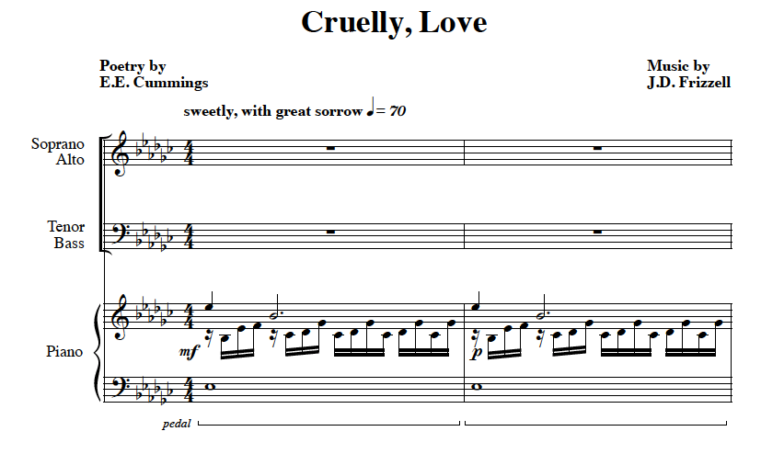
Music Theory
What is the key signature of this piece? Is it major or minor? Why?

Slide 14
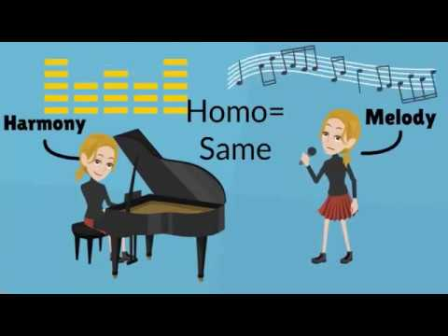
In music, texture is the way harmonies, melodies, rhythms, and timbres (like different instruments) relate to the overall effect of a piece of music.
Monophony
A single melodic line
Homophony
Primary melody line with harmonies on the same rhythm
Polyphony
Two or more independent melodic lines
Heterophony
Multiple voices or instruments performing a single melody with slight variation

Slide 15
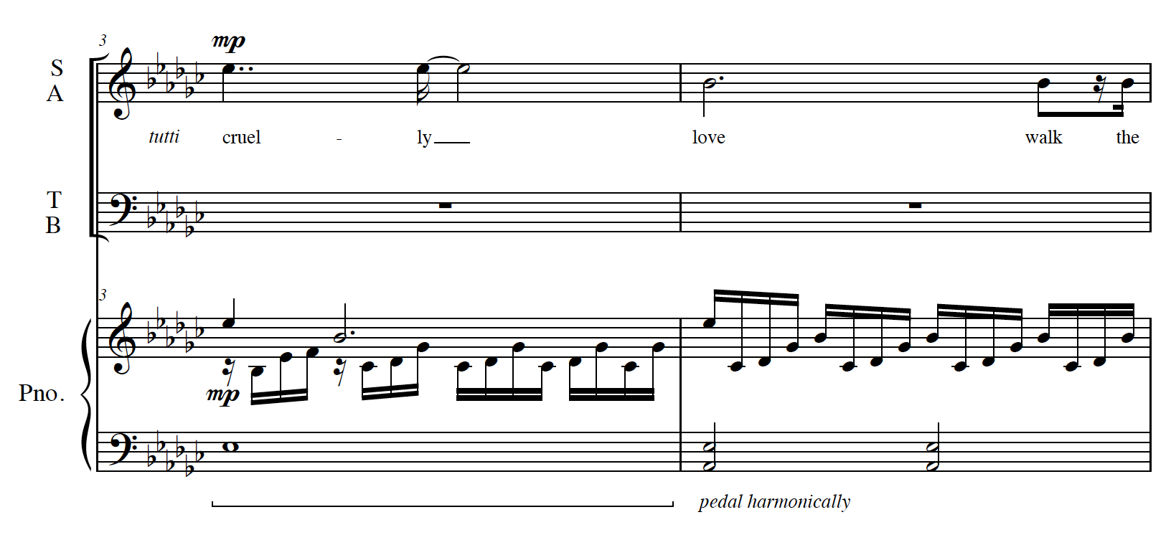
What is the texture at measure 3?
What does
“tutti” mean?

Slide 16
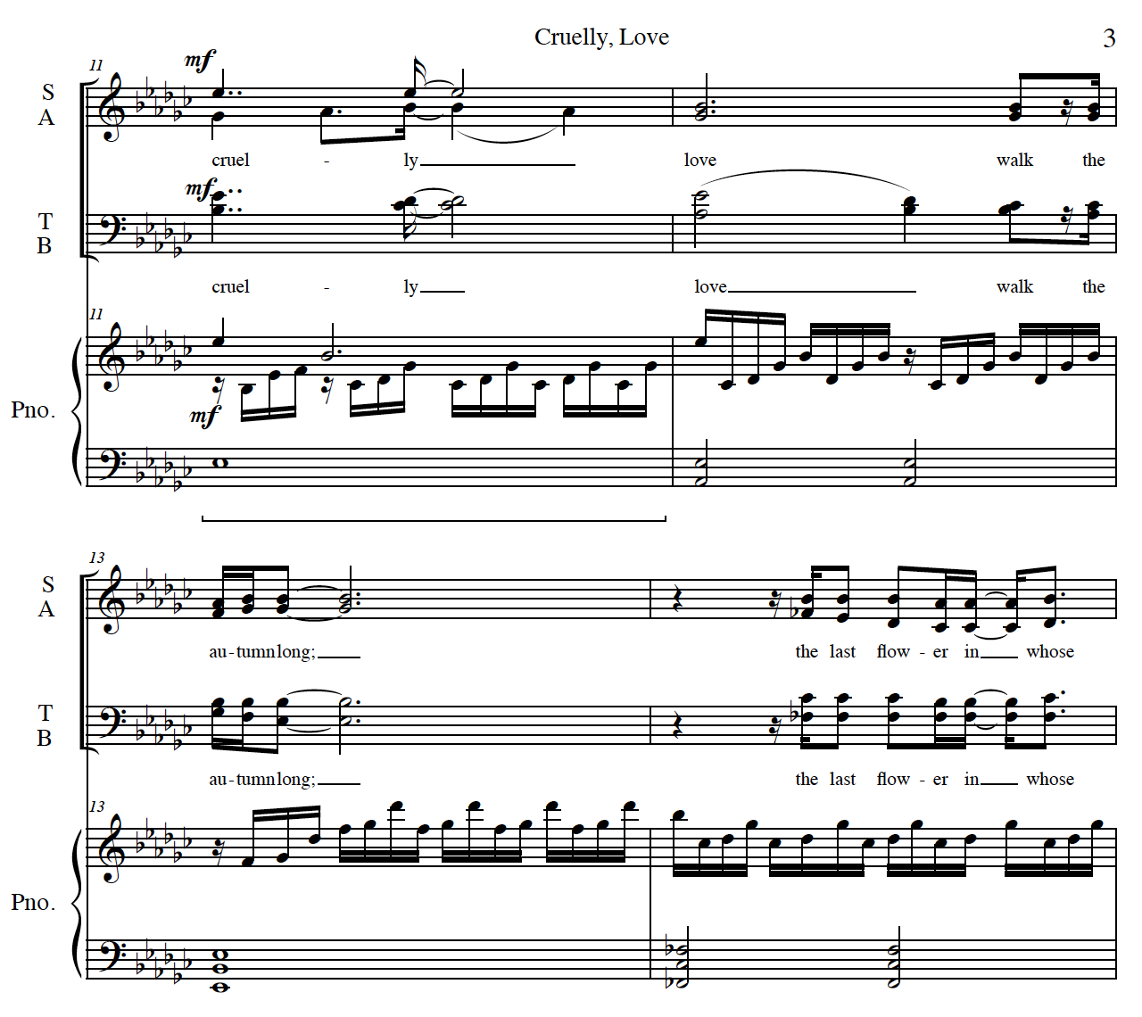
What does the dynamic at measure 11 mean?
How does the texture change at measure 11?
What is the curved line in the alto part in measure 11?

Slide 17
Modulation is the change from one tonality or tonal center to another.

Slide 18
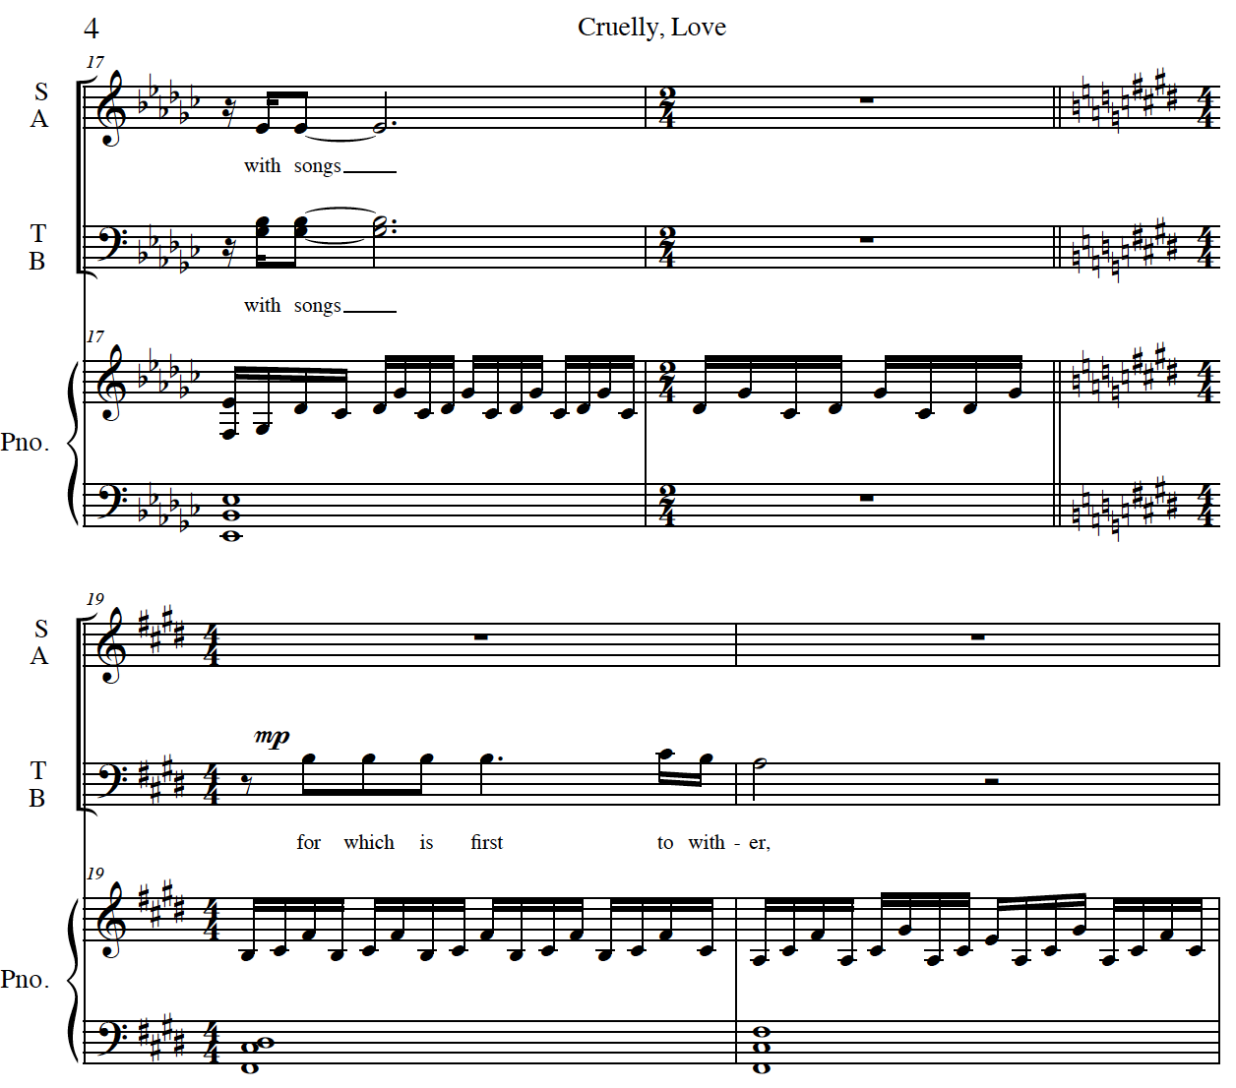
Music Theory
The key change from measure 18 to 19 uses what is called a common tone modulation.
A common tone modulation typically uses one sustained or repeated note to connect two very distant keys.

Slide 19
Music Theory
What key does this section start in? What key does it end up in?
What common tones are used to connect these keys? **hint- they are spelled enharmonically**
enharmonically-relating to notes that are the same in pitch (in modern tuning) though bearing different names (e.g., F sharp and G flat or B and C flat).

Slide 20
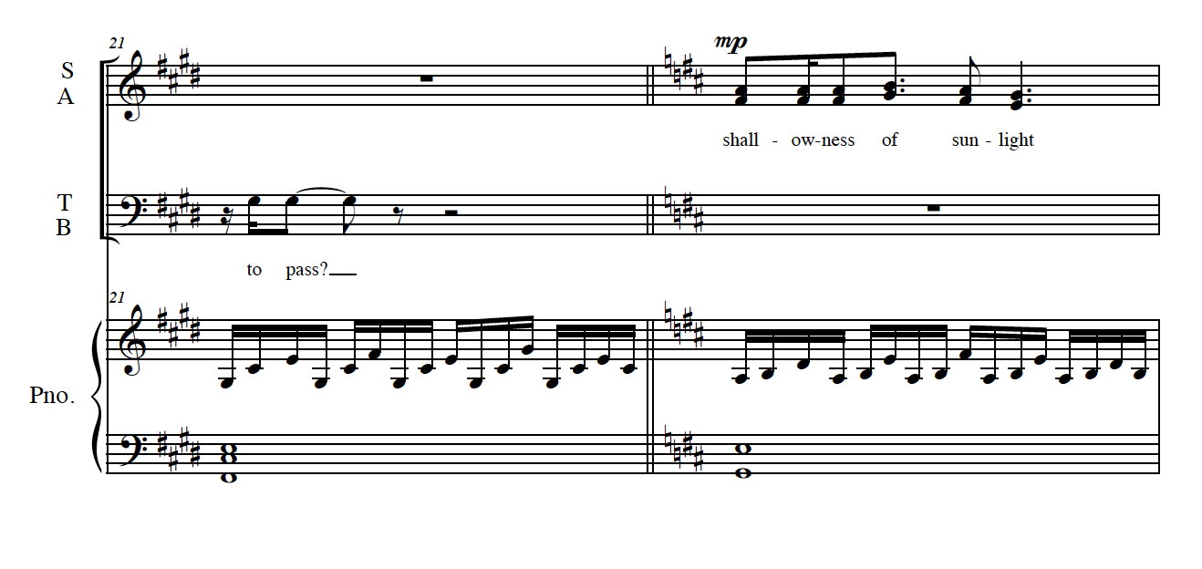
Music Theory
Another key change happens from measure 21 to 22. This time, it is a common chord modulation. A common chord modulation uses an entire chord that exists in both the old key and the new one.
F# minor⁷
E: ii⁷/
D: iii⁷

Slide 21
Vocal Technique
Practice singing the opening phrase of “cruelly, love”.
Record yourself singing this opening phrase. If the range is uncomfortable, sing your voice part’s line in the repeated phrase.
Keys for success:
A strong initial breath and onset with a “c” consonant on “cruelly”
Immediate movement from “c” to an “oo” vowel with only a short flipped “r” between
Utilizing tall, open vowels throughout the phrase

Slide 22
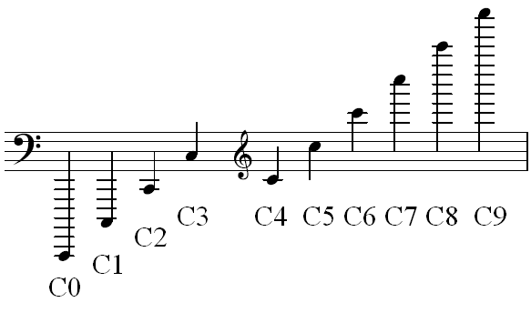
Vocal Technique
Range consists of the lowest to the highest note that your voice can phonate, or sing.
Useable range typically does not include notes on the low end that you cannot produce reliably. Useable range also does not include notes on the high end that require considerable strain or tension.
Look through the entire piece.
What is the range of your voice part
for “cruelly, love?”
Example: D3 to E flat 4

Slide 23
Discussion Prompt
“Music matters because people matter”
Dr. J.D. Frizzell
What does this quote mean to you?
How has your attitude towards singing and making music changed during the past year?
How has the relative isolation of 2020 impacted your perception of the importance of your friends and family?

