Slide 1


Slide 2

THE TOTAL
CHORAL
WARM UP
Lesson by Dr. J.D. Frizzell

Slide 3
BREATHING AND PHONATION

Slide 4

BREATHING AND PHONATION
The first part of singing is breathing– and we want to do it well. Breathing for singing is different than the involuntary breathing we do most of the day.
Lungs are just an organ. They don’t actually do anything on their own. They rely on multiple sets of muscles to help inhale and exhale air.

Slide 5

BREATHING AND PHONATION
You may have heard your choir teacher say at some point to “breathe from your diaphragm”. This simply means that you can focus on breathing lower rather than higher so you can most fully utilize the diaphragm. This allows the maximum amount of air to enter the lungs.
Phonation is simply the production of sound.

Slide 6
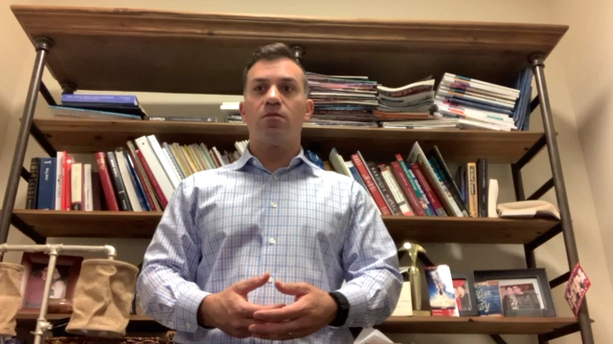
BREATHING AND PHONATION
Warm Up Exercise 1
Take a deep breath in as if you are breathing through a straw. Use an “oo” vowel for this. Gesture your hands and arms down low and out.

Slide 7
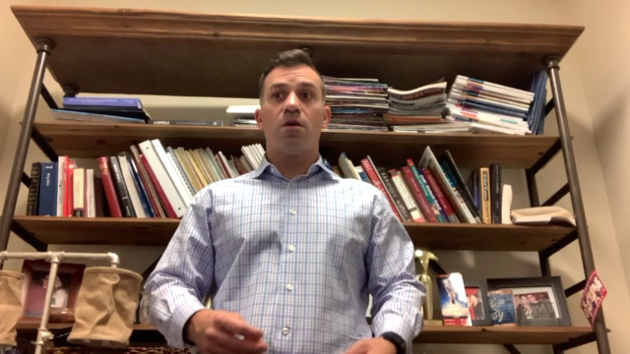
BREATHING AND PHONATION
Warm Up Exercise 1
Now let’s inhale for 4 beats and exhale for 4 beats. Repeat with 3 beats, then 2 beats, then 1.
You should aim to get the same amount of air in for 1 beat that you do for 4 beats.

Slide 8
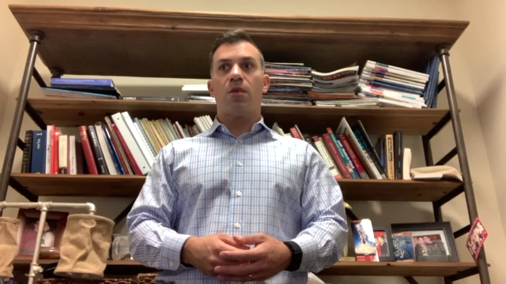
BREATHING AND PHONATION
Warm Up Exercise 1
Now let’s go in the opposite direction. This will teach your lungs and respiratory muscles that you have a greater capacity for air than you think you do.
Inhale for 4, exhale for 4, then 5,6,7, and 8 beats.

Slide 9

← Click here to play sounds on each slide
BREATHING AND PHONATION
Warm Up Exercise 2
Transition back to inhaling for 4 beats and start humming on a G sharp.
Keys to success:
Focus on creating a lot of space inside your mouth.
Make sure your teeth aren’t touching.
Feel for vibration and resonance in your nose and face.
Try to keep the pitch, volume, and placement as even as possible throughout the entire note.

Slide 10
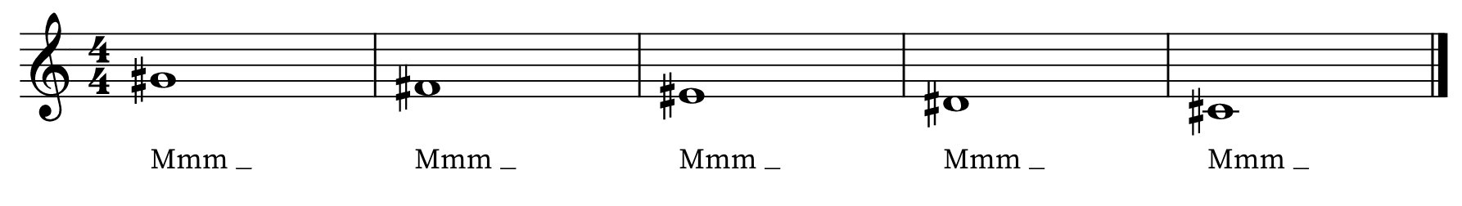
BREATHING AND PHONATION
Warm Up Exercise 2
Take another deep, low breath. Sing an F sharp. Repeat this process down the scale.

Slide 11
BREATHING AND PHONATION
Warm Up Exercise 2
Once you have sung each note individually, take one breath and sing all five notes in succession. Then go up a half step and repeat. Continue up by half step, repeating until you get to a C# or D.

Slide 12
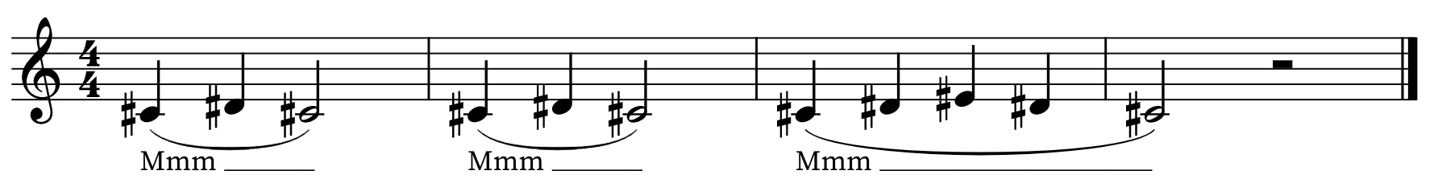
BREATHING AND PHONATION
Warm Up Exercise 3
Another phonation warmup is also on a hum.

Slide 13
ARTICULATIONS AND DYNAMICS

Slide 14
ARTICULATIONS AND DYNAMICS
Now that we have covered breathing and phonation, we continue by focusing on articulations and dynamics.
Articulations are the way we perform each individual note (connected, separated, accented, etc.).
Dynamics are the volume or intensity with with we sing each note (soft, loud, medium soft, gradually louder, etc.).

Slide 15
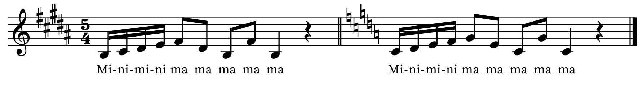
ARTICULATIONS AND DYNAMICS
Warm Up Exercise 4
Accents and dynamics

Slide 16
ARTICULATIONS AND DYNAMICS
Warm Up Exercise 4
“Mini mini ma ma ma”
Watch the accents, staccato, legato, and dynamic markings carefully!

Slide 17
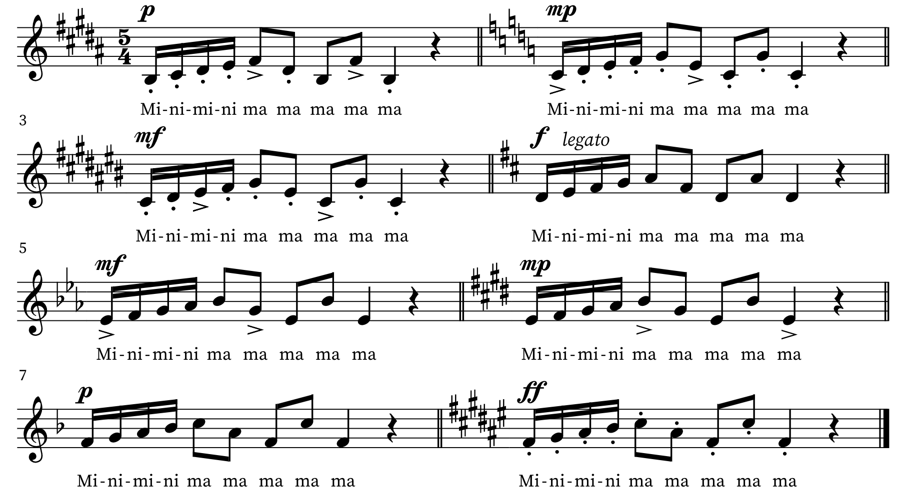
ARTICULATIONS AND DYNAMICS

Slide 18
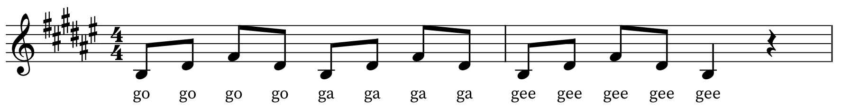
ARTICULATIONS AND DYNAMICS
Warm Up Exercise 5
“Go Go Ga Ga Gee Gee”
Listen for the dynamic and articulation changes that will be called out in between each iteration of this exercise.

Slide 19
PLACEMENT

Slide 20
PLACEMENT
Placement is how you position your vocal resonance within your body. You have a few main resonating chambers that are used for singing:
Oral cavity (mouth)
Nasal cavity
Larynx (throat)
Sinus cavity

Slide 21
PLACEMENT
The next exercise uses the voiced consonant “N” to focus the resonance into the nasal and sinus cavities. A voiced consonant is a consonant that carries pitch.
It also combines that “N” with “ya” to help raise the soft palate. This is the soft tissue at the top and back of your mouth. It raises involuntarily when you yawn (try it!), but can be trained to be a voluntary muscle.
When the soft palate is raised, it creates more space in the oral cavity for resonance and helps project the sound more towards the front of your face.

Slide 22
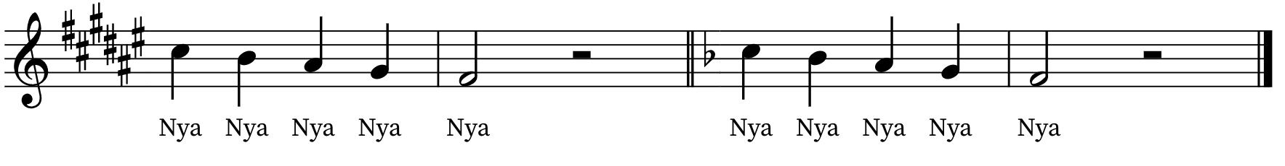
PLACEMENT
Warm Up Exercise 6
Nya Nya Nya
All voice parts should sing this in the same octave (as written). It should be purposefully bright and forward to activate the nasal and sinus cavities for resonance. This may be difficult for male voices, especially during voice change!

Slide 23
PLACEMENT
One of the other benefits of this exercise is that you can continue it as low as possible to test range for low alto or bass voices. Be careful never to push. Use brightness and those nasal and sinus cavities to help ease down into your lower range.
You can also change the vowel than you use for this exercise. Instead of “Nya”, try “Nee”, “Nay”, and “Noi”.
Teachers: If you want to work on navigating the break more for treble voices, randomize the pitch patterns instead of going straight down by half step.

Slide 24
RANGE EXTENSION

Slide 25
RANGE EXTENSION
Range extension is simply the act of warming up the vocal musculature into pitch areas that are not used in normal speaking. Vocal muscles must be warmed up the same way any other muscles would be before exercising.
Our vocal musculature actually warms up quite a bit throughout the day due to normal talking. However, just like an athlete may walk around all day before practice, they need to stretch and warm up before they start sprinting. Range extension is extra important earlier in the morning.

Slide 26
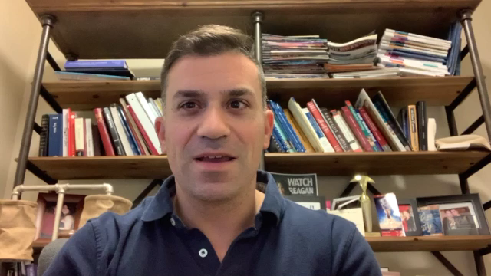
RANGE EXTENSION
Warm Up Exercise 7
Lip or Tongue Trill
Take a low, deep breath and buzz your lips together as shown in the video. Sing up a perfect fifth then back down to the original note, all in the same breath. A more advanced version of this exercise uses a tongue trill instead of a lip trill. Watch the demonstration video for how to do the tongue trill.

Slide 27
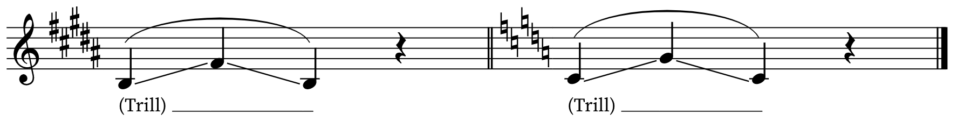
RANGE EXTENSION
Warm Up Exercise 7
Lip or Tongue Trill

Slide 28
RANGE EXTENSION
Warm Up Exercise 8
Crazy Sound
This one is just fun. It not only helps extend the range, it pulls people out of their shell and encourages them to use their voice freely. The director simply calls on a singer and says, “NAME, Crazy Sound!” Once that person does a crazy sound, everyone in the choir mimics it back. Rinse and repeat with random singers. Online rehearsals– watch that mute button!

Slide 29
RANGE EXTENSION
Warm Up Exercise 9
Octave Arpeggios
This is the widest range of all of our warm ups. Each iteration of this exercise spans an entire octave. The key is keeping it light and easy- avoid pushing and avoid overly accenting the top note.
Get a good bright, forward placement from the “ee” vowel and keep the placement there for more resonance with the “Ah” vowel. Make sure you have a tall, open, pure vowel on “Ah”.

Slide 30
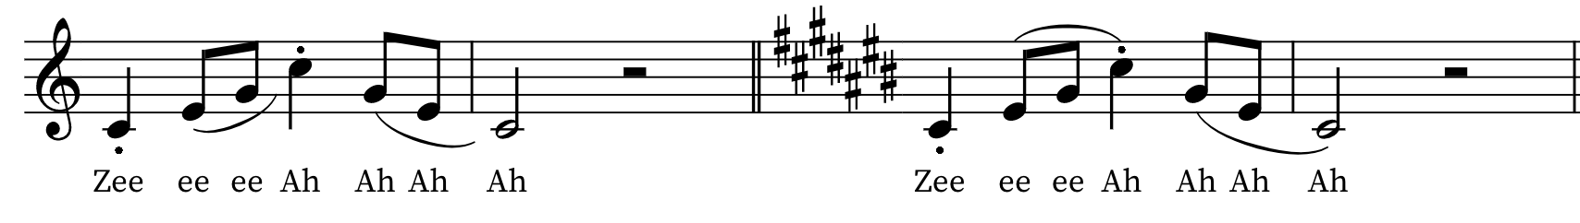
RANGE EXTENSION
Warm Up Exercise 9
Octave Arpeggios

Slide 31
RANGE EXTENSION
Warm Up Exercise 10
Sing Yah
Another warm up with an octave range, Sing Yah uses a slide to help connect the lower register to the higher register of the voice.
Think about connecting the bottom note to the top note, sliding as much as possible while moving through the “Ngyah” sound. Open up to a tall, open, pure “Ah” vowel at the top and make sure it stays tall on the way back down.

Slide 32
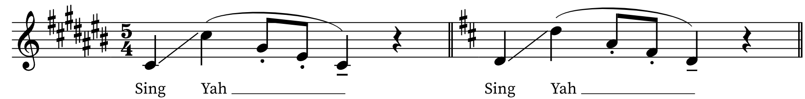
RANGE EXTENSION
Warm Up Exercise 10

Slide 33
SCALES

Slide 34
SCALES
Warm Up Exercise 11
Major Scale
Sing a major scale on either solfege or numbers, depending on which one your choir uses.
If you are able to see and respond to your director, watch them carefully. Directors– use scales as a chance to make the choir watch you. Change tempo, dynamics, and articulations throughout!

Slide 35
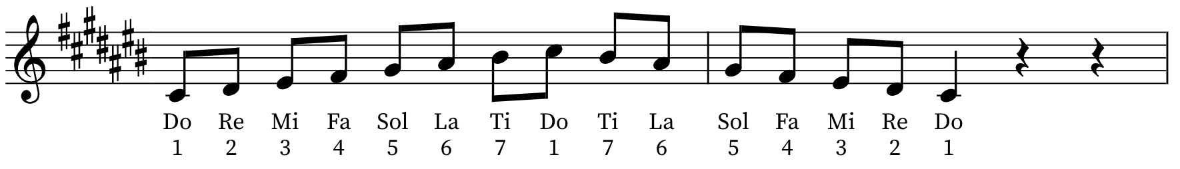
SCALES
Warm Up Exercise 11
Major Scale

Slide 36
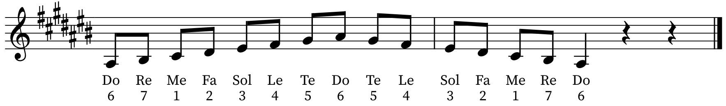
SCALES
Warm Up Exercise 12
Natural Minor Scale

Slide 37
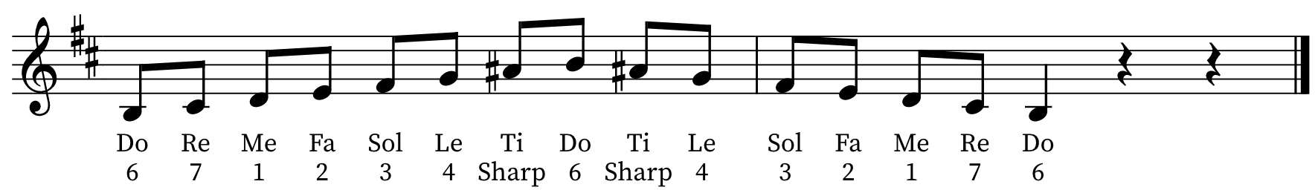
SCALES
Warm Up Exercise 13
Harmonic Minor Scale

Slide 38
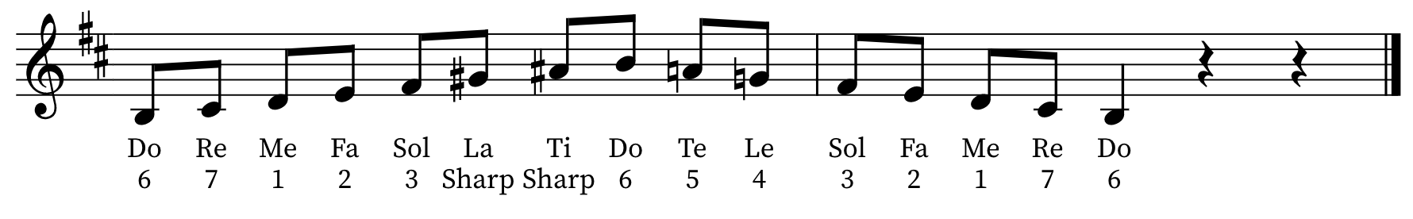
SCALES
Warm Up Exercise 14
Melodic Minor Scale

